Slide 1
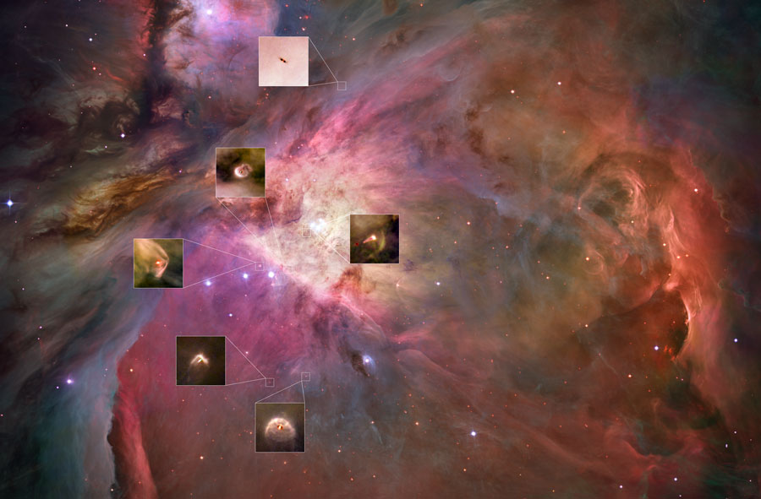
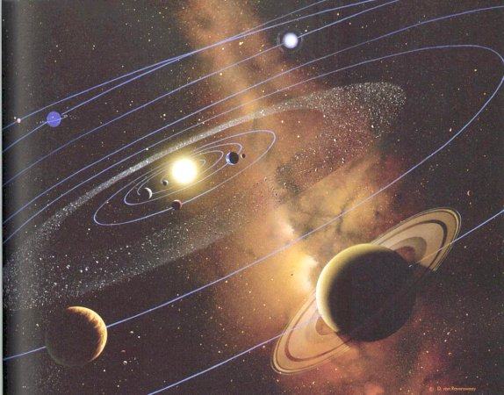
PLANET FORMATION AND MIGRATION
Alessandro Morbidelli
CNRS/Obs. De la Cote d’Azur, Nice, France

Slide 2
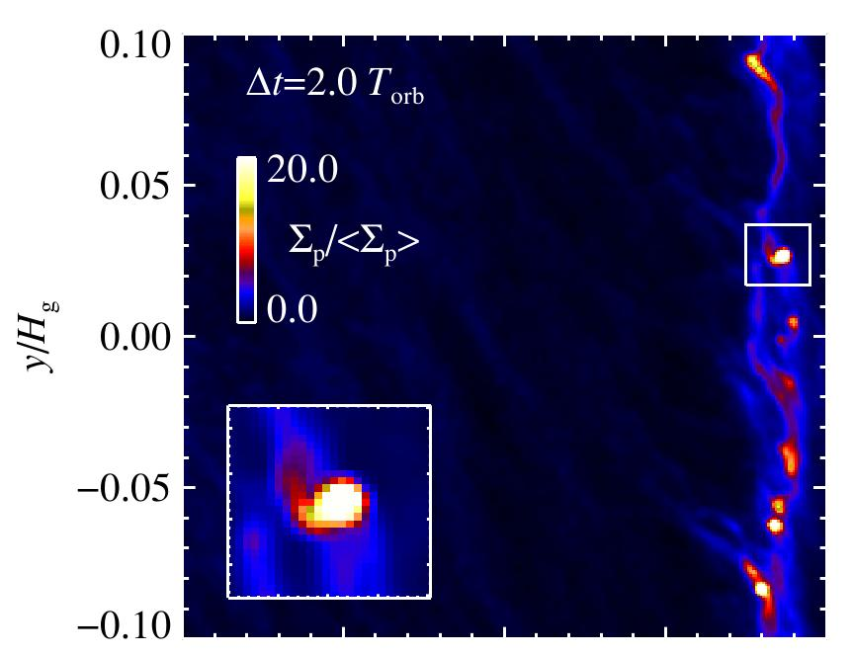
Beyond the first planetesimals
Once the first planetesimals are formed they still reside in a disk of gas and pebbles.
Thus they can still accrete pebbles flowing by them in the disk
“Pebble accretion process” (Johansen and lacerda, 2010; Ormel and Klahr, 2010; Murray-Clay et al., 2011; Lambrechts and Johansen, 2012)

Slide 3
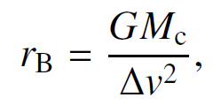
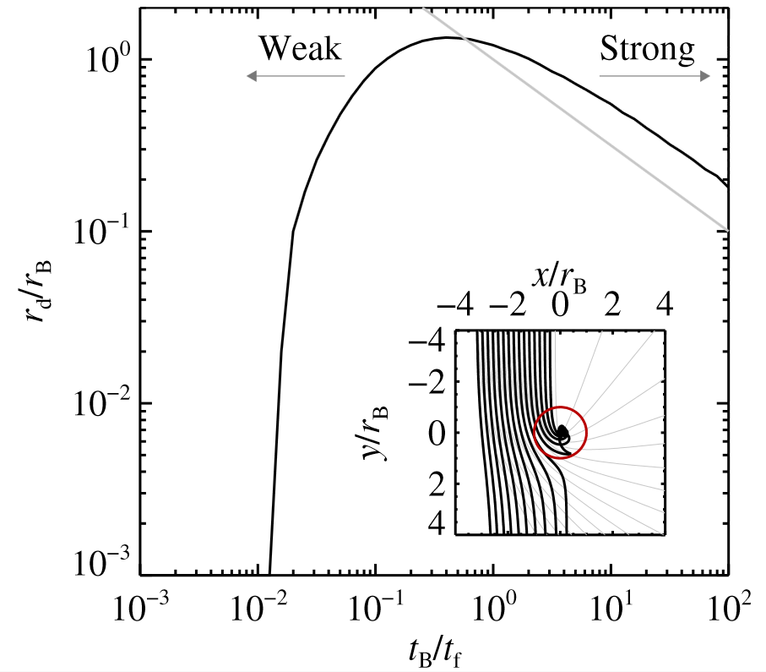
Pebble accretion
Bondi Radius:
headwind speed
Accretion Rate:
(if mass equally distributed at all pebble sizes:
dM/dt ~ M²; runaway-growth
If mass only in one pebble-size:
dM/dt ~ M; threshold-growth)
When r_{d} > H_{pebbles}
When r_{d} > r_{H}~ M^{1/3}
(oligarchic-growth)

Slide 4
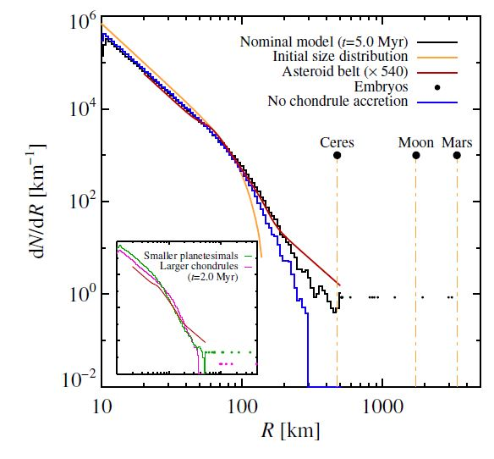
Growth of asteroids by chondrule accretion (Johansen et al., 2015)

Slide 5
Reproducing both the asteroid belt and the Kuiper belt SFD using pebble accretion (Lambrechts et al., in preparation)

Slide 6
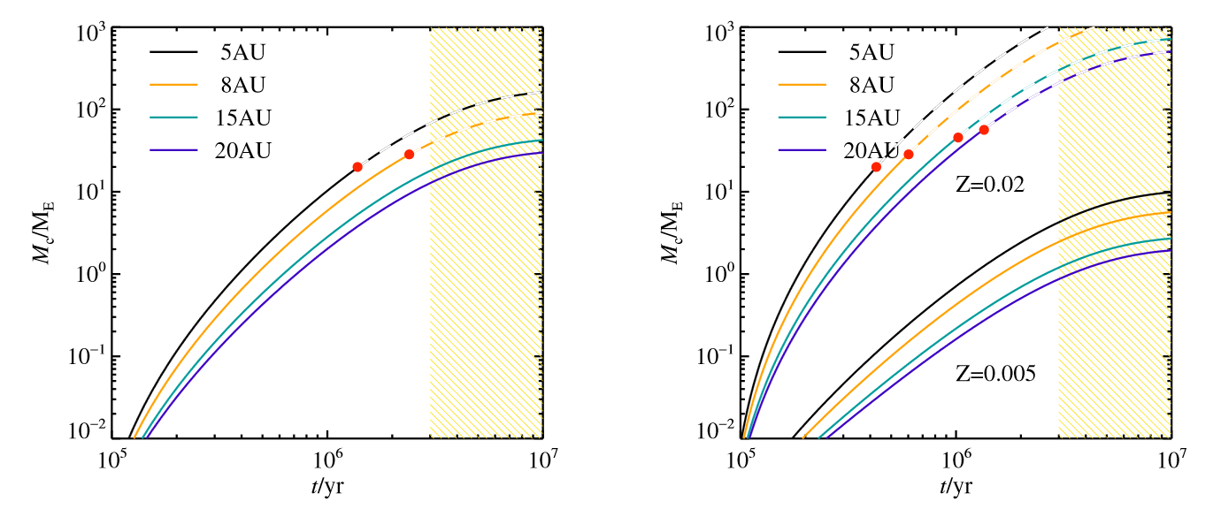
Formidable planet growth rates in the outer solar system.
Z=0.01
Lambrechts and Johansen, 2014

Slide 7
How many giant planet cores can be formed by pebble accretion, given the oligarchic nature of the process? Not many, due to a combination of gravitational stirring and dynamical friction
(Levison et al., 2015)

Slide 8
A brief tutorial on planet migration
A planet launches a spiral density wave in the disk

Slide 9
A brief tutorial on planet migration
The outer wake exerts a negative torque on the planet
The inner wake lead the planet
WHO WINS?
The inner wake exerts a positive torque on the planet
The outer wake trails the planet

Slide 10
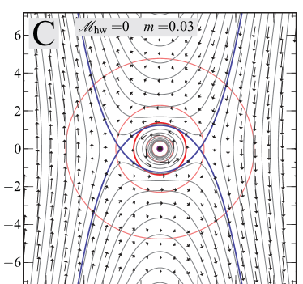
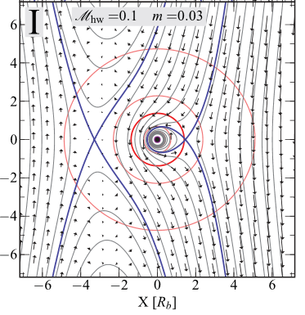
Case with no pressure support of the disk
TYPE I MIGRATION
Y
The outer wake wins.
Because the disk is sub-keplerian, the horseshoe region is shifted inwards. Thus the perturbation is much stronger for the streamlines in the outer disk.
Planets migrate inwards
Their speed is proportional to their mass
Y
Case with pressure support of the disk
Ormel , 2012

Slide 11
The coorbital corotation torque

Slide 12
In a region with a positive surface density gradient the corotation torque is positive and can dominate the negative torque from the wake

Slide 13
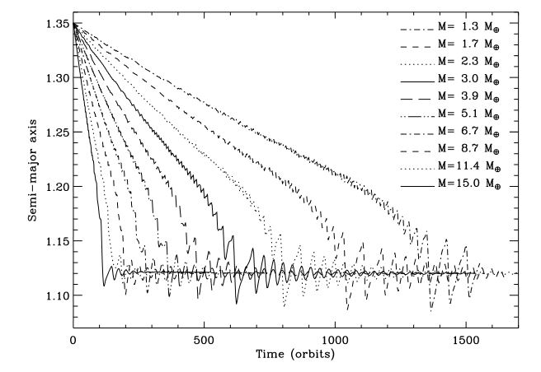
All planets stop migrating in the same place, regardless of their mass, unless they are too massive (torque saturation)

Slide 14
Torque saturation: the libration of fluid elements tends to make the density in the horseshoe region “uniform” (0-torque). The disk tends to restore the initial profile through its internal evolution

Slide 16
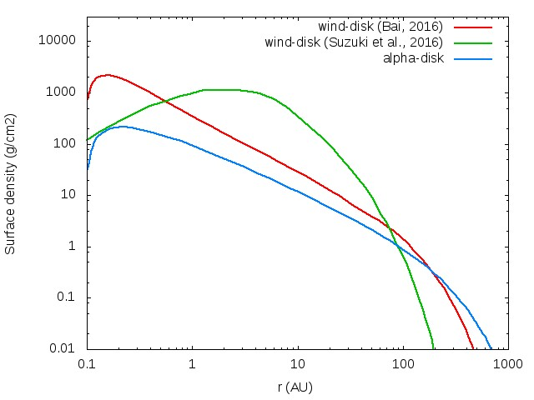
The planet trap mechanism is relevant where there is a positive and steep gradient of the surface density of the disk, i.e. at the inner edge or even farther out in some wind dominated disk models.

Slide 17
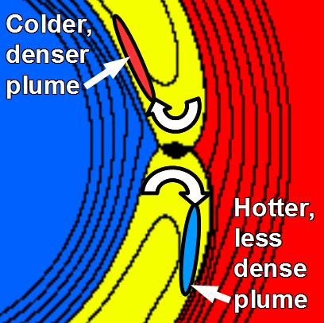
Also if the temperature gradient is steep, a positive torque arises from the horseshoe region
Needs disks where gas acquires the “local” temperature slowly
Paardekooper & Mellema (2006),
Baruteau & Masset (2008),
Masset & Casoli (2009)‏
Kley and Crida, 2008

Slide 18
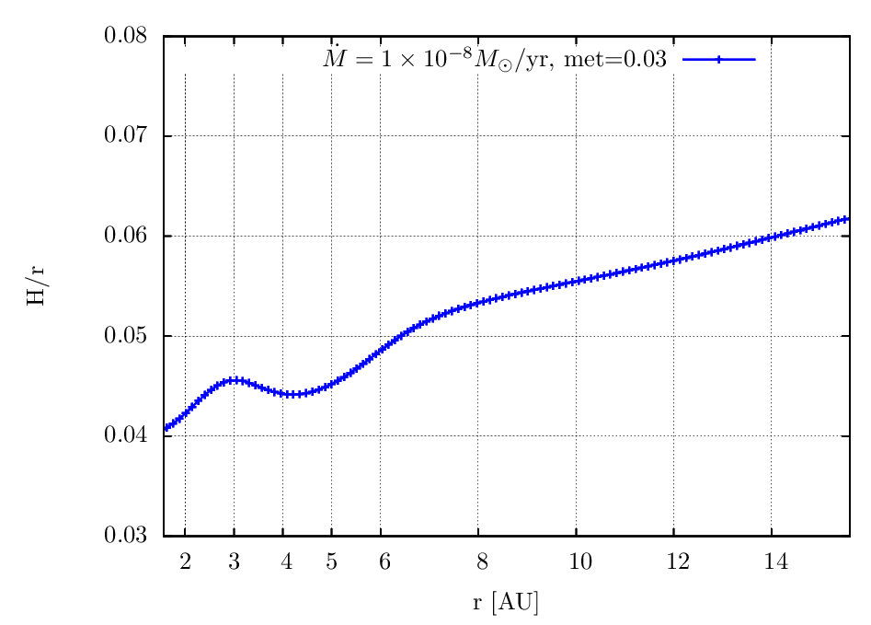
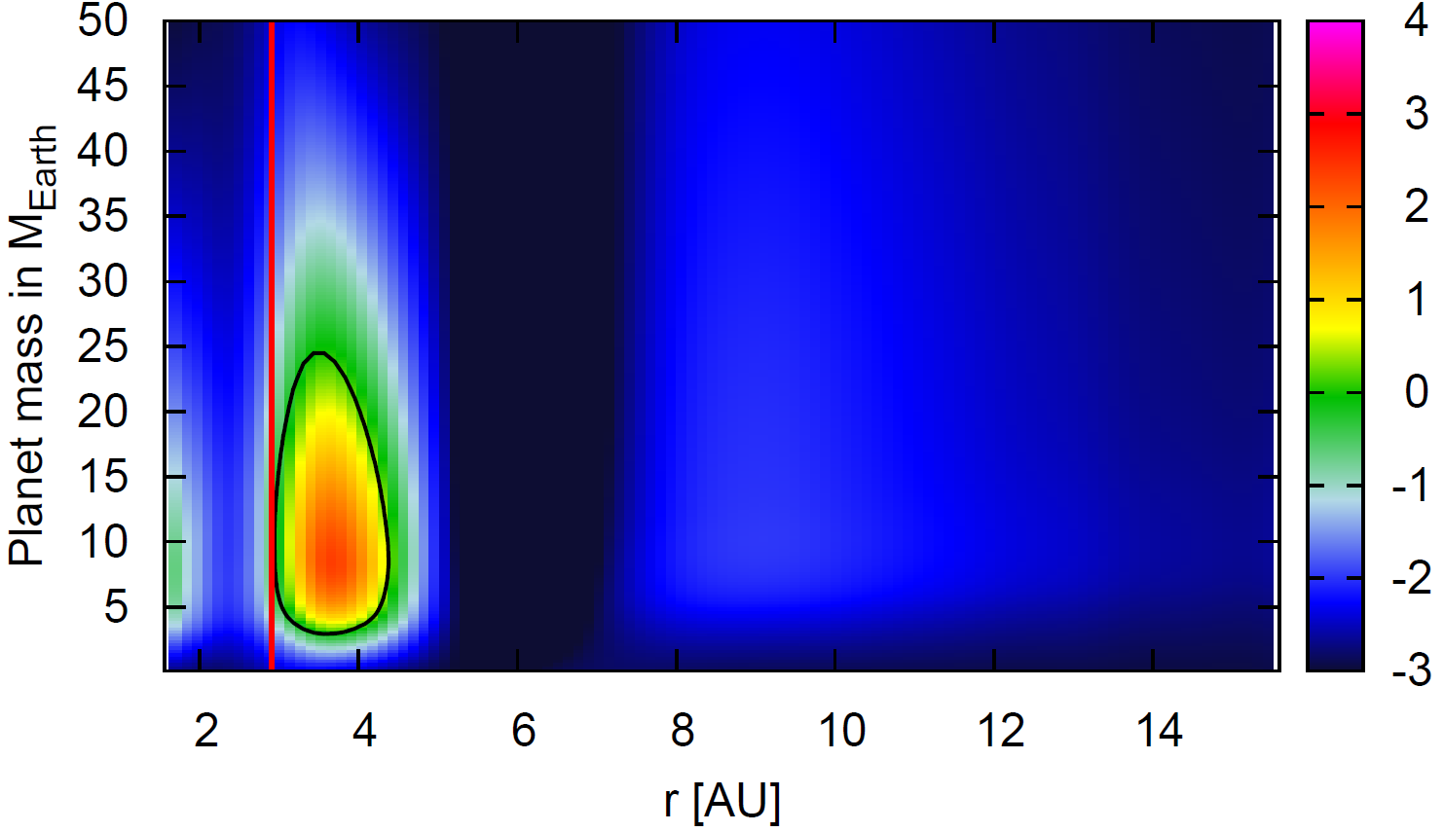
Migration vs. planetary mass in a realistic disk
H/r
snowlinee
dM/dt=10⁻⁸M_{sun}/y
Migration rate
Inward Outward
Bitsch et al., 2014

Slide 19
Migration vs. planetary mass in a realistic disk
snowlinee
dM/dt=10⁻⁸M_{sun}/y
saturated
Migration rate
Inward Outward
~ isothermal
Bitsch et al., 2014

Slide 20
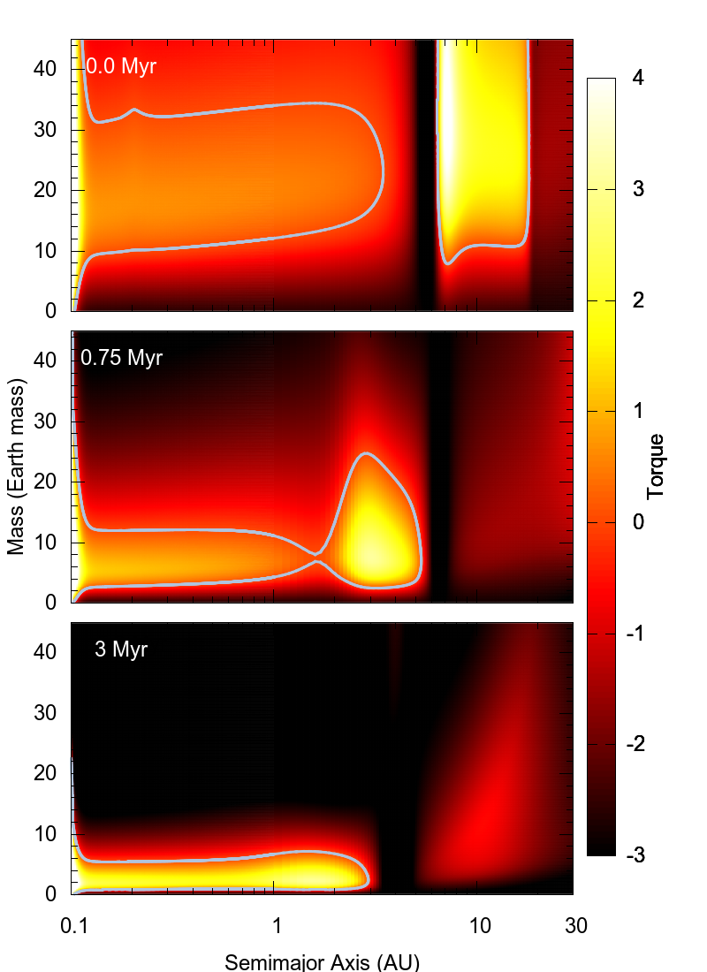
The outward migration region evolves as the disk evolves (loses mass and cools down). Inward migration is resumed for planets smaller and smaller as time passes
Eventually all planets are released to migration

Slide 21
Massive planets and gap opening
The planet accelerates the outer disk and pushes it forward and decelerates the inner disk and pushes it inwards.
If the force exerted by the planet overcomes the internal disk forces, a gap opens

Slide 22
Massive planets and gap opening
The planet accelerates the outer disk and pushes it forward and decelerates the inner disk and pushes it inwards.
If the force exerted by the planet overcomes the internal disk forces, a gap opens

Slide 23
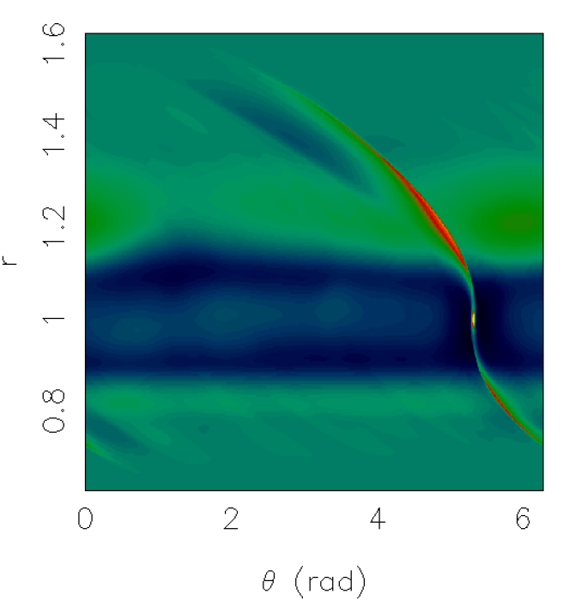
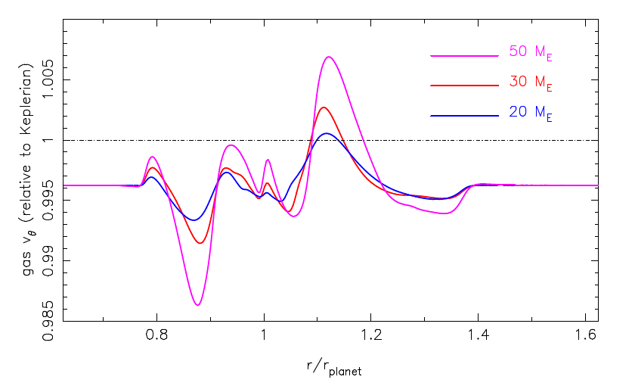
Not so massive planets (~ 20 Earth masses) can open a shallow gap enough to cut the flow of pebbles to the inner disk
Lambrechts, Johansen and Morbidelli, 2014; Morbidelli and Nesvorny, 2012

Slide 25
NOT SO TRUE!
When the disk is at equilibrium with the planet the planet is not at equilibrium with the disk (Dürmann and W. Kley, 2015)

Slide 26
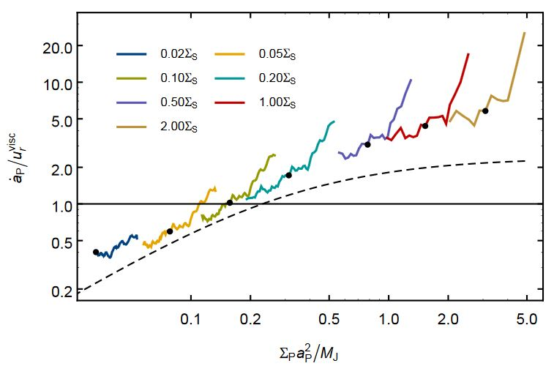
Dürmann and W. Kley, 2015

Slide 27
In general, Type II migration is slower than Type I migration

Slide 28
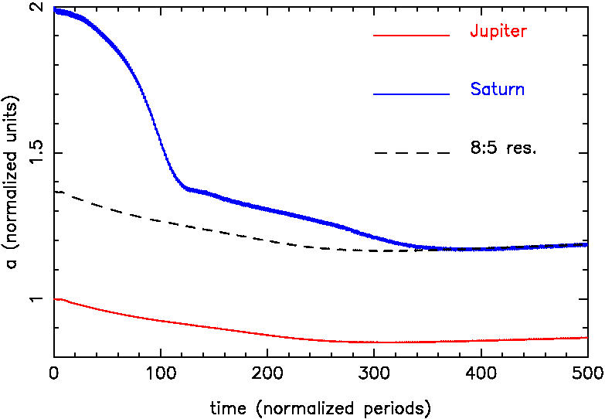
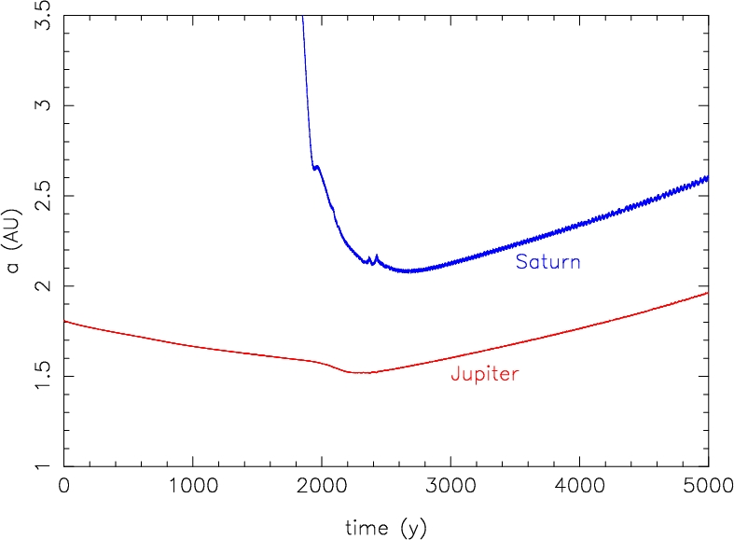
Type II migration can be slowed down/reversed if there are 2 planets with a good mass ratio
Masset and Snellgrove, 2001
(large H/r)
r
Morbidelli and Crida, 2007
(small H/r)

Slide 29
Why?

Slide 30
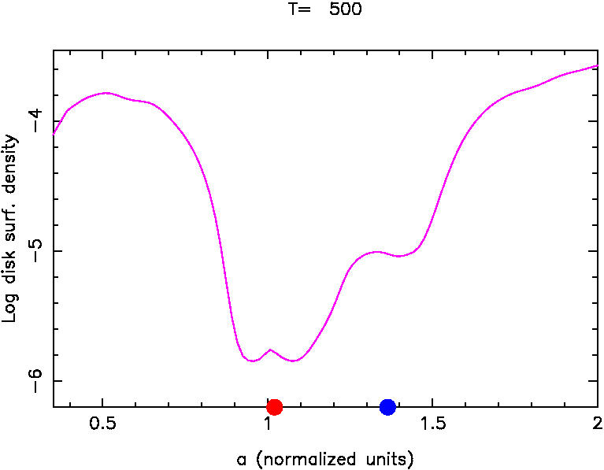

Slide 31
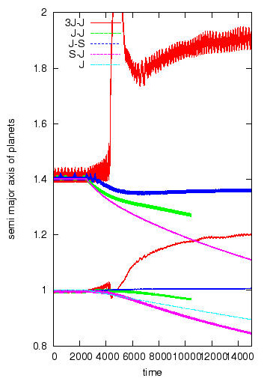
This mechanism works ONLY for a mass ratio close to Jupiter/Saturn, and if the planets are sufficiently close (relative to their masses).

Slide 32
