Slide 1
Proto-planetary disks and planetesimal accretion
A. Morbidelli – OCA, Nice

Slide 2
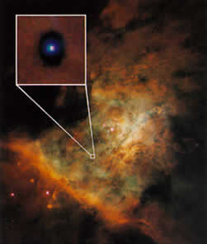
The proto-planetary disk
Proto-Soleil

Slide 3
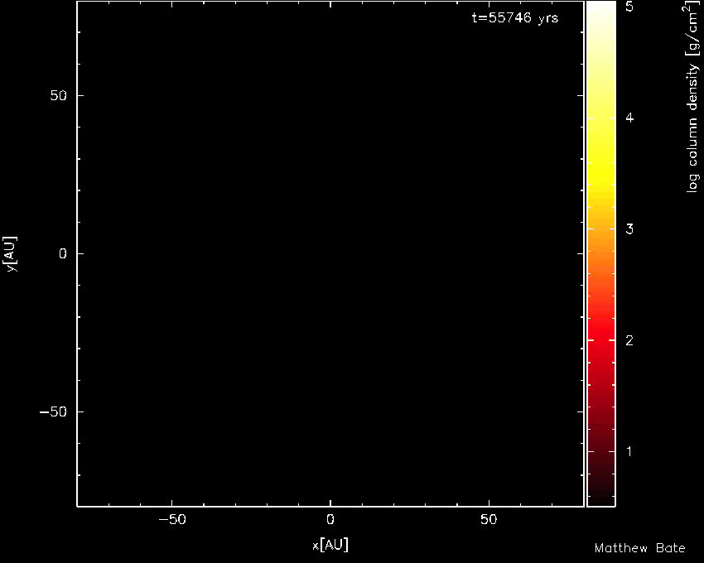
Modern modeling of disk formation: Bate, M. R., 2011, MNRAS

Slide 4
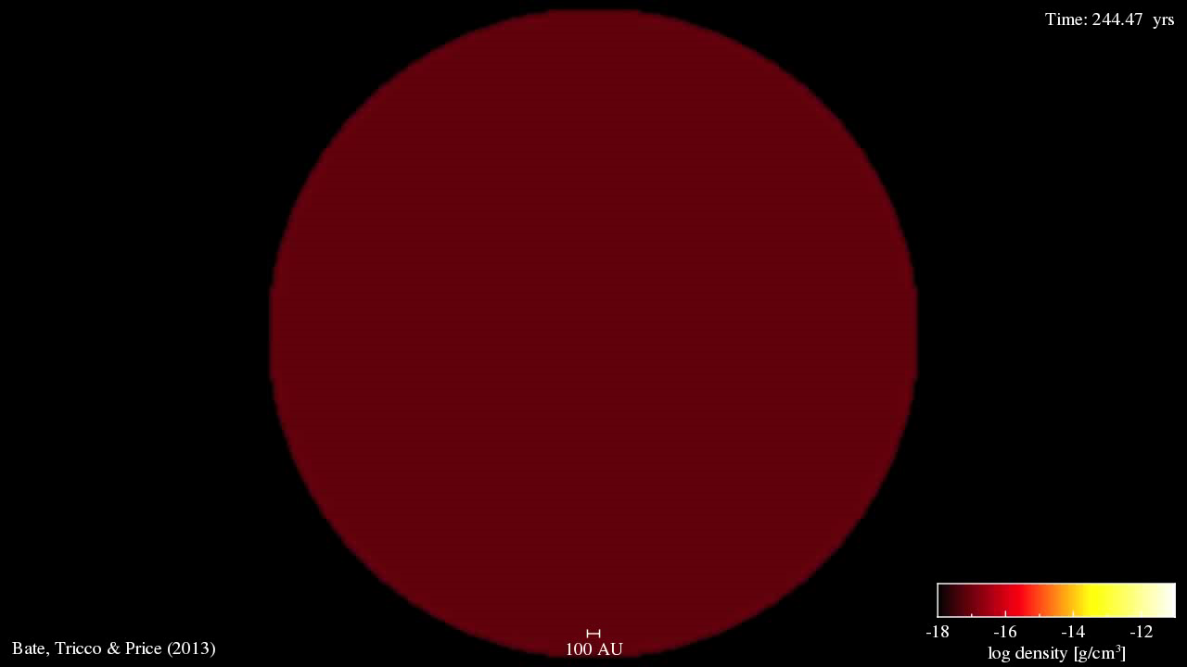

Slide 5
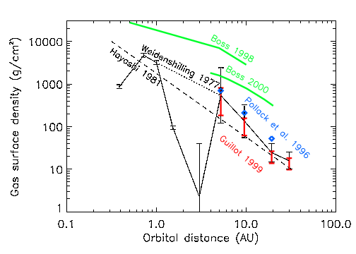
Transport in the proto-planetary disk
-δT=dJ/dt
-d/dr(3πΣνr^{1/2})δr =d/dt(2πr δr Σ r^{1/2}) = v_{r}d/dr(2 πr^{3/2} δr Σ)
v_{r}=-3/2 ν/r
T=3πΣνr²Ω
dM/dt=2πrΣv_{r}= Const
-> νΣ=Const
ν~r ou r^{1/2}
Σ=1/r (for ν~r)
dM/dt=2πrΣv_{r}= Const
The MMSN concept

Slide 6
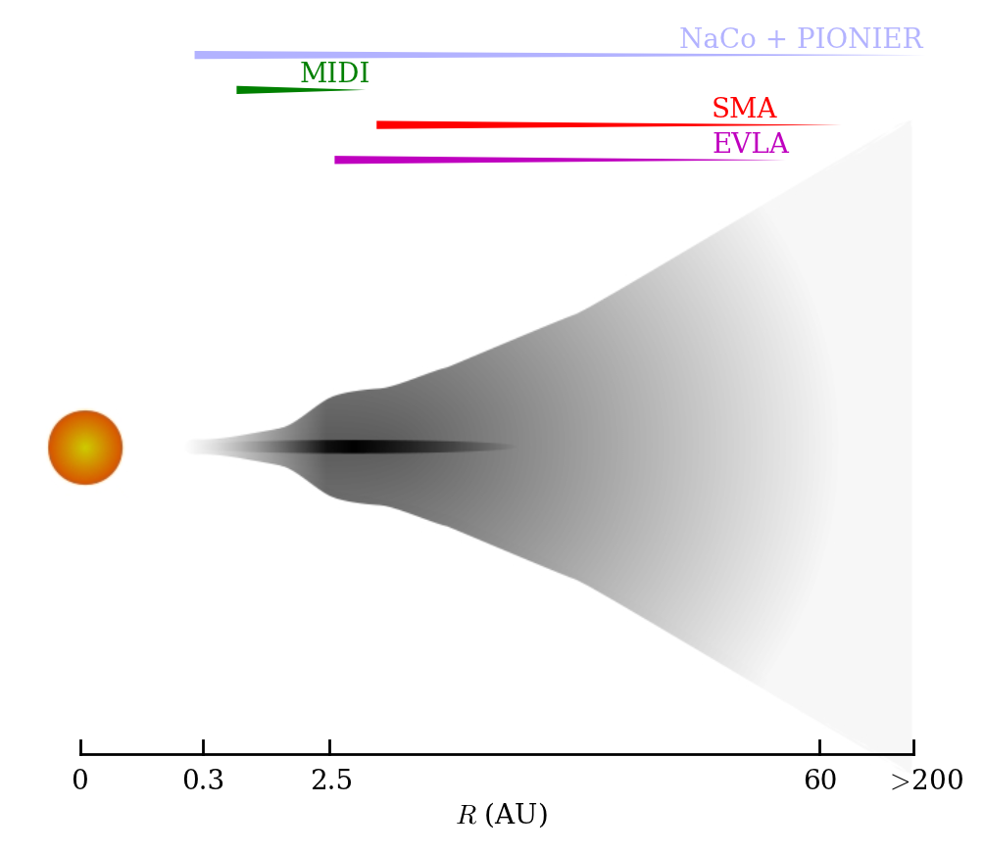



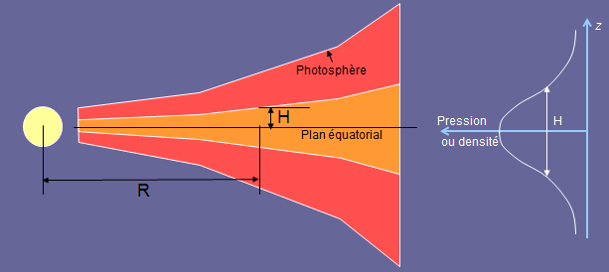
Vertical structure of the disk
The gas must be in a vertical hydrostatic equilibrium:
centifugal
gravitational
pressure
(perfect gas law)
H=(R/μ T r³)^{1/2} Disk’s height
Pressure scale height

Slide 7

H(r)?
Stellar irradiation:
z
r
Heating : L_{sun}/(4 π r²) x 2 x 2πr x δH where δH = r d(H/r)/dr δr
Cooling: 2 x 2πr x δr x σ T⁴ (black body)
Remember: H=(R/μ T r³)^{1/2}
Solution of Heating=Cooling: H/r = h₀ r^{2/7} (flared disk)

Slide 8
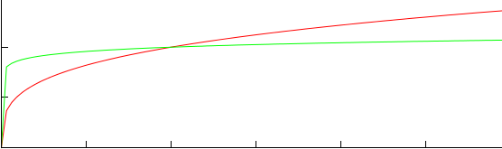

H(r)?
Viscous heating:
H/r
Viscous heating dominated
Irradiation dominated
r
Viscous Heating :
Cooling: 2 x 2πr x δr x σ T⁴ /κΣ
Remember: H=(R/μ T r³)^{1/2} ; νΣ=Const.
Solution of Heating=Cooling: H/r = h₀ (r/ν)^{1/8} = h₀ r^{1/20} (for ν~ αH²Ω – Shakura & Sunyaev, 1973)

Slide 9
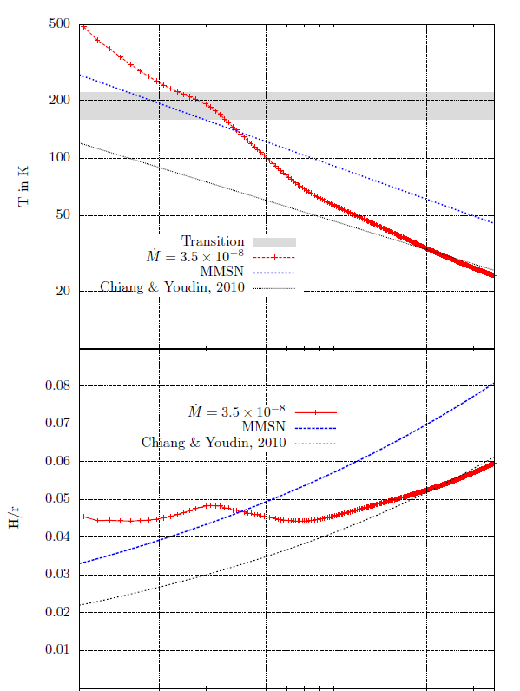
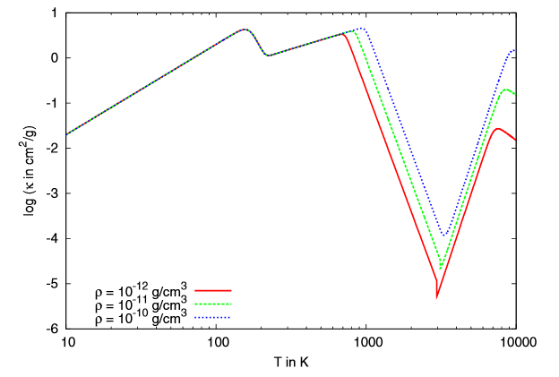
The opacity is not constant!
1/r^{1/2} line
1/r line
Bell and Lin (1994)
Bitsch et al., 2014

Slide 10
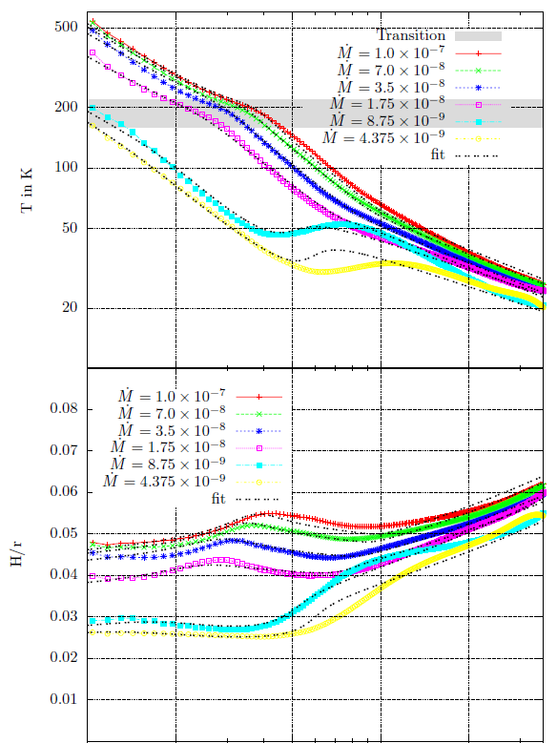
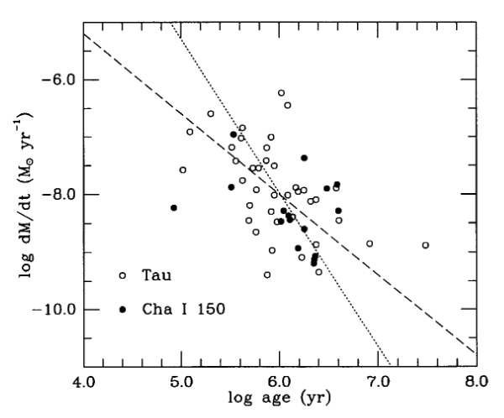
Disk evolution over time
Accretion time of chondrites
Hartmann et al. (1994)
References on the snowline problem:
Oka et al. 2011; Martin and Livio 2012, 2013; Hubbard and Ebel, 2014; Bitsch et al., 2014
Bitsch et al., 2014

Slide 11
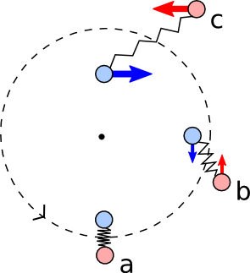
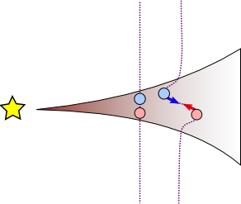
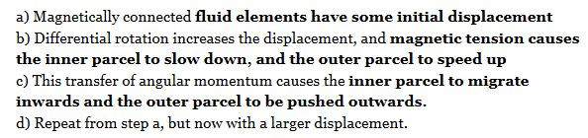
Turbulence, dead-zones and related stuff
Accretion rates of 10⁻⁷ – 10⁻⁸ M_{sun}/y require a quite strong viscosity, many orders of magnitude larger than the molecular viscosity of the gas
It is believed that the origin of viscosity is turbulence. But, what is the source of turbulence?
MRI

Slide 12
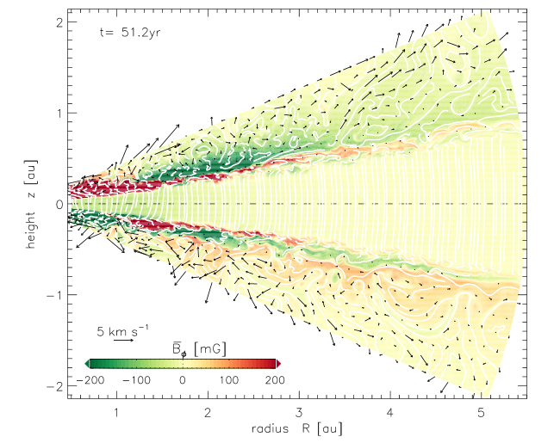
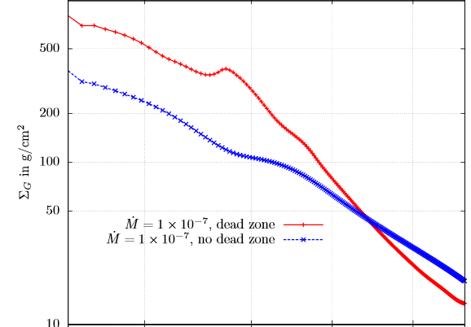
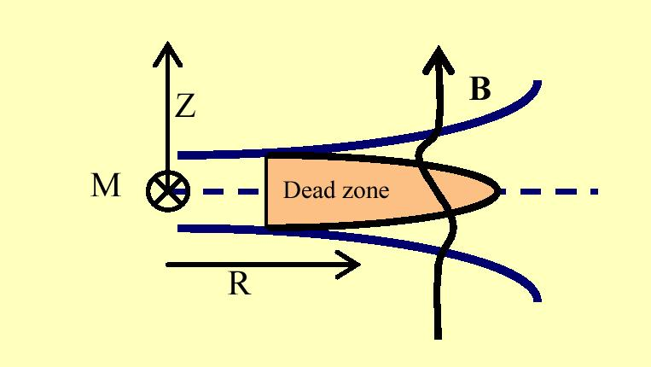
Turbulence, dead-zones and related stuff
MRI can work only where the disk is ionized
Bitsch et al., 2014a
MRI
A huge pile-up of gas in the dead zone?
NO!!!

Slide 13
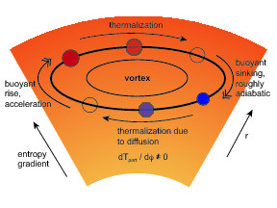
Turbulence, continued
There are many other sources of turbulence, although probably weaker:
Baroclinic instability (Klahr and Bodenheimer, 2003; Klahr, 2004; Lyra and Klahr, 2011; Raettig et al., 2013)
Particle-gas differential motion (Kelvin Helmoltz instability – Weidenschilling, 1995
Streaming instability – Youdin and Goodman, 2005)
Vertical shear instability (Nelson et al., 2013)
So, the dead zone is not really dead
Scheme of vertical shear instability
Scheme of baroclinic instability

Slide 14

Turbulence, continued
There are many other sources of turbulence, although probably weaker:
Baroclinic instability (Klahr and Bodenheimer, 2003; Klahr, 2004; Lyra and Klahr, 2011; Raettig et al., 2013)
Particle-gas differential motion (Kelvin Helmoltz instability – Weidenschilling, 1995
Streaming instability – Youdin and Goodman, 2005)
Vertical shear instability (Nelson et al., 2013)
So, the dead zone is not really dead
Besides, the MRI picture might not be true. MRI may always be quenched by ambipolar diffusion:
Bai and Stone, 2011, 2013a,b
Lesur et al., 2013, 2014
Gressel et al., 2015

Slide 15
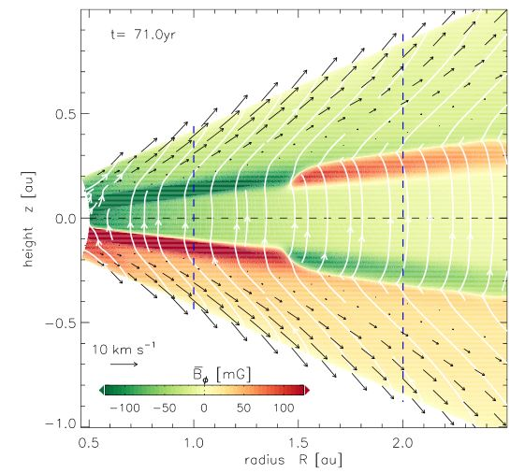
Disk winds: a new paradigm for transport in the disk
Gressel et al., 2015

Slide 16
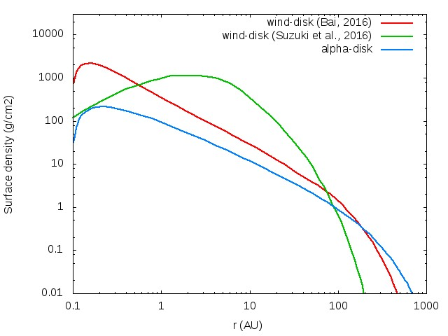
Disk surface density distribution in disk wind models

Slide 17
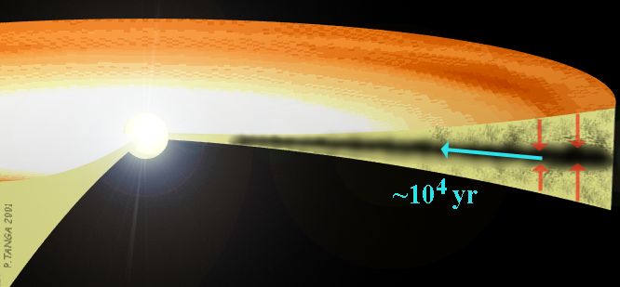
PLANETESIMAL FORMATION

Slide 18
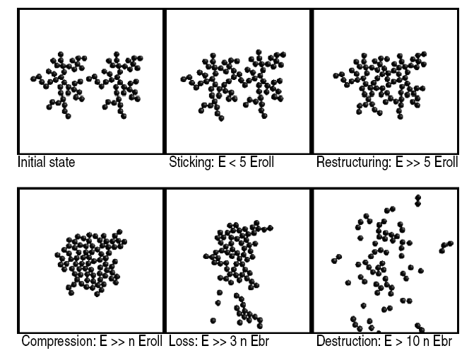
Aggregate-aggregate collisions: results
Dominik, Tielens (1997) – Wurm, Blum (2000)

Slide 19
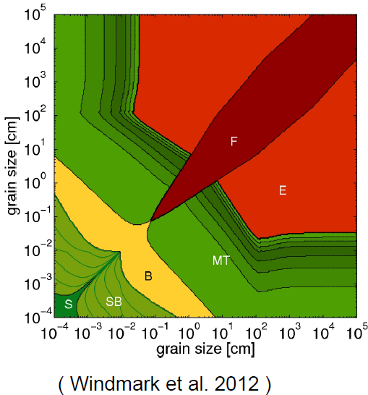
Accreting, bouncing, breaking…..

Slide 20
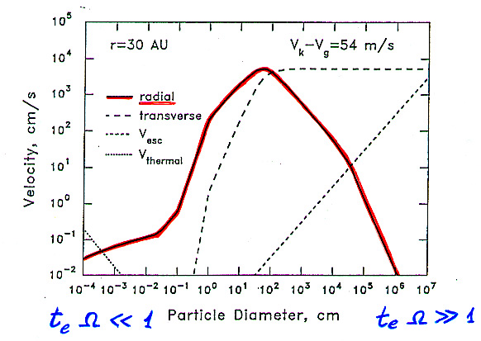
Sunward dust fall
Dust particles run headwind
-> fast radial drift of m-size boulders
« meter-size barrier »
Weindenschilling, 1977
Particle-particle collisions do not seem a way to form planetesimals. Despite 50 years of effort, no model seems to explain the formation of planetesimals.
A new idea that is gaining momentum: self-gravitating clumps of small particles

Slide 21
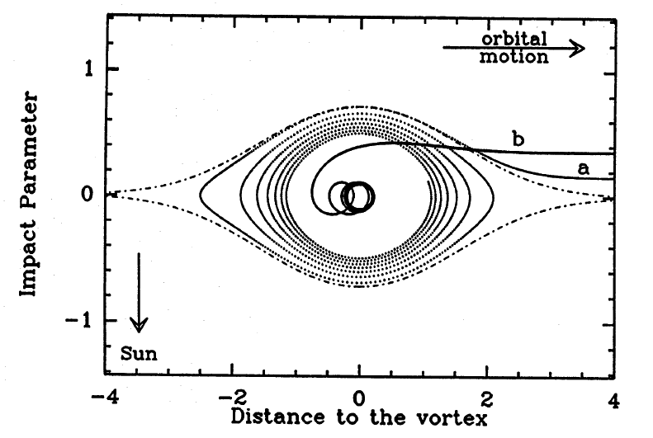
Consider a turbulent disk. 10cm-1m particles are captured in pressure maxima (e.g. a vortex)
H
L

Slide 22
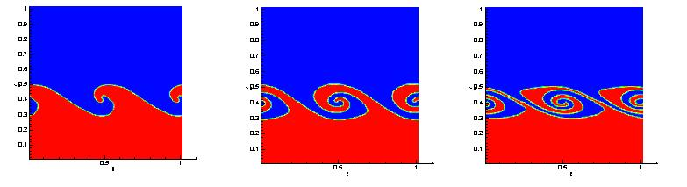
Particles can generate turbulence themselves
z
Settled particles would create an overdense layer:
  back reaction on gas
  vertical velocity gradient (shear)
Kelvin-Helmoltz instability?
v_{g}
v_{k}

Slide 23
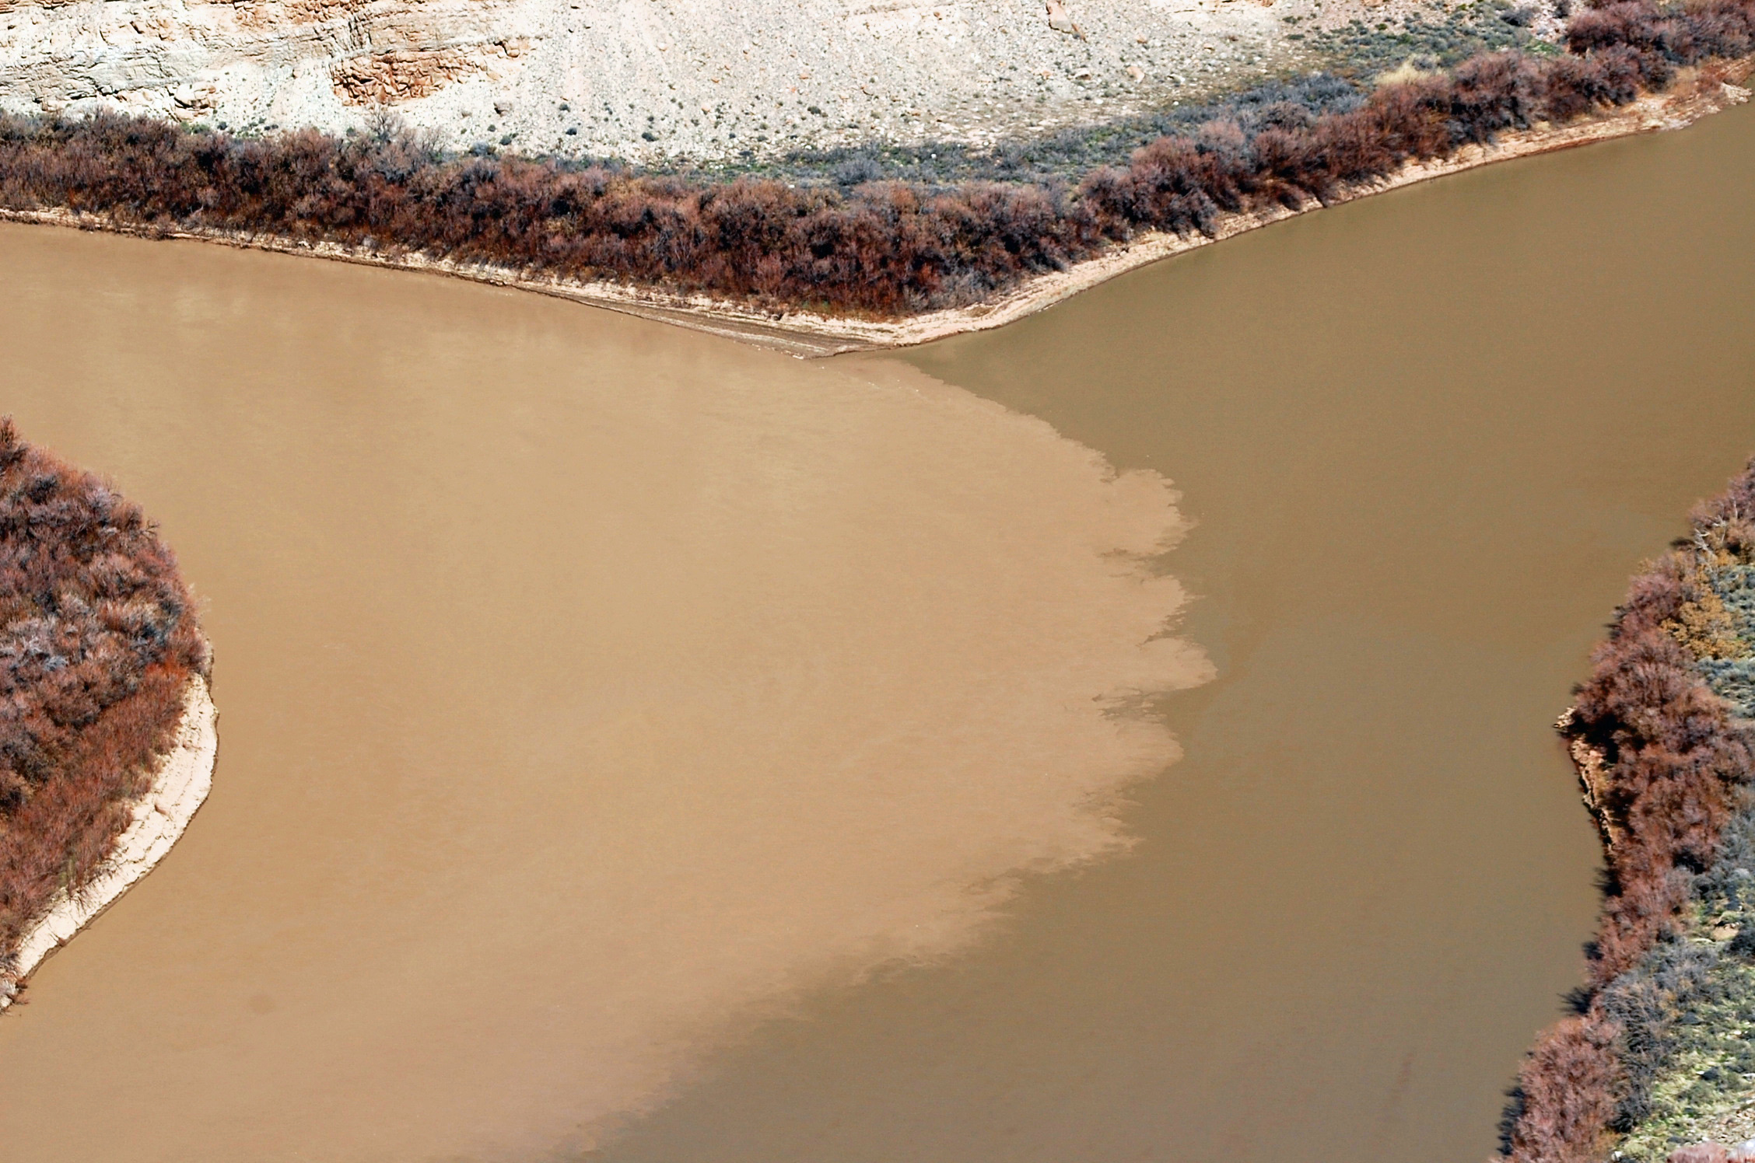
Colorado river
Green river
Canyonlands National Park – Utah

Slide 24
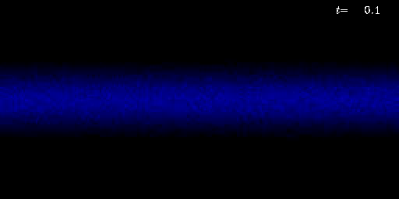
A numerical demonstration (Johansen et al., 2006)
Veritcal direction
0
Azimuthal direction

Slide 25
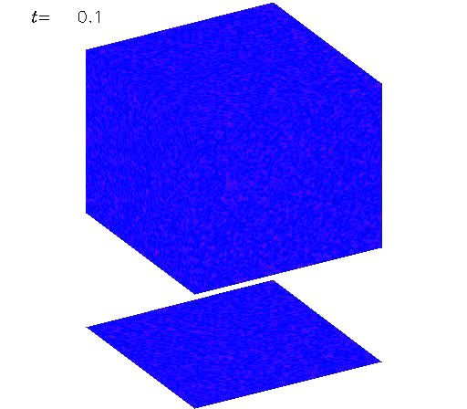
Streaming instability (Youdin and Goodman, 2005) – clumping of radially drifting particles
z
θ
r
From Johansen’s webpage : http://www.astro.lu.se/~anders/research.php

Slide 26
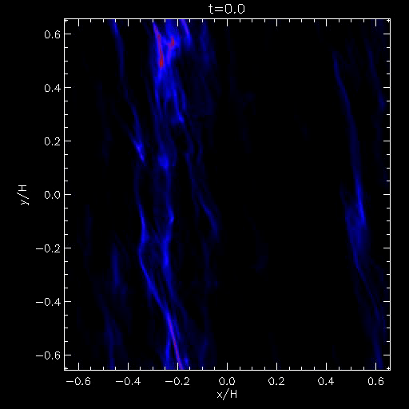
Formation of planetesimals as self-gravitating clumps of pebbles: Johansen, Oishi, Low, Klahr, Henning, Youdin; Nature, 2007
Azimuthal direction
Radial direction
Particle size distribution: 15 - 60 cm

Slide 27
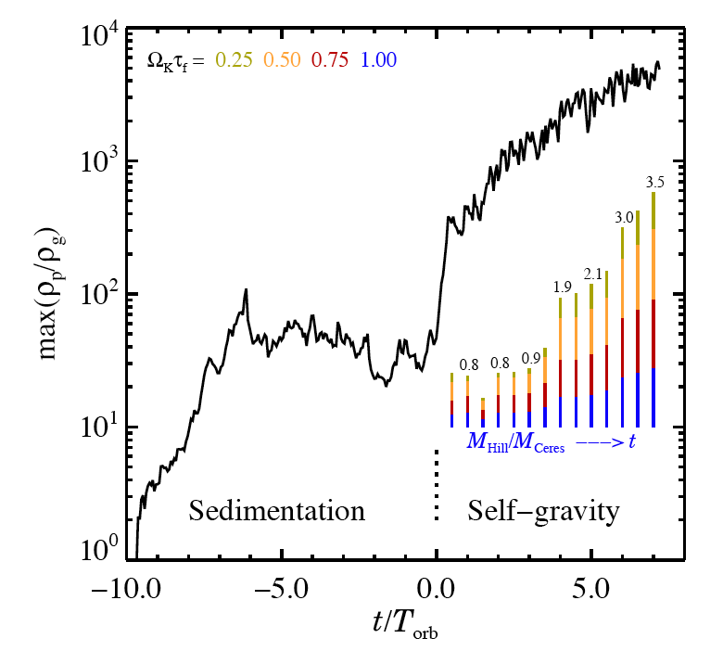
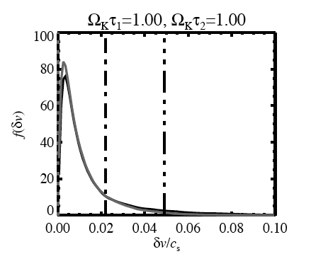
Formation of LARGE planetesimals by local gravitational instability
15cm 60cm
Rubble pile de-strucion
Solid body destruction
Relative collision velocities inside a clump should not be of concern

Slide 28
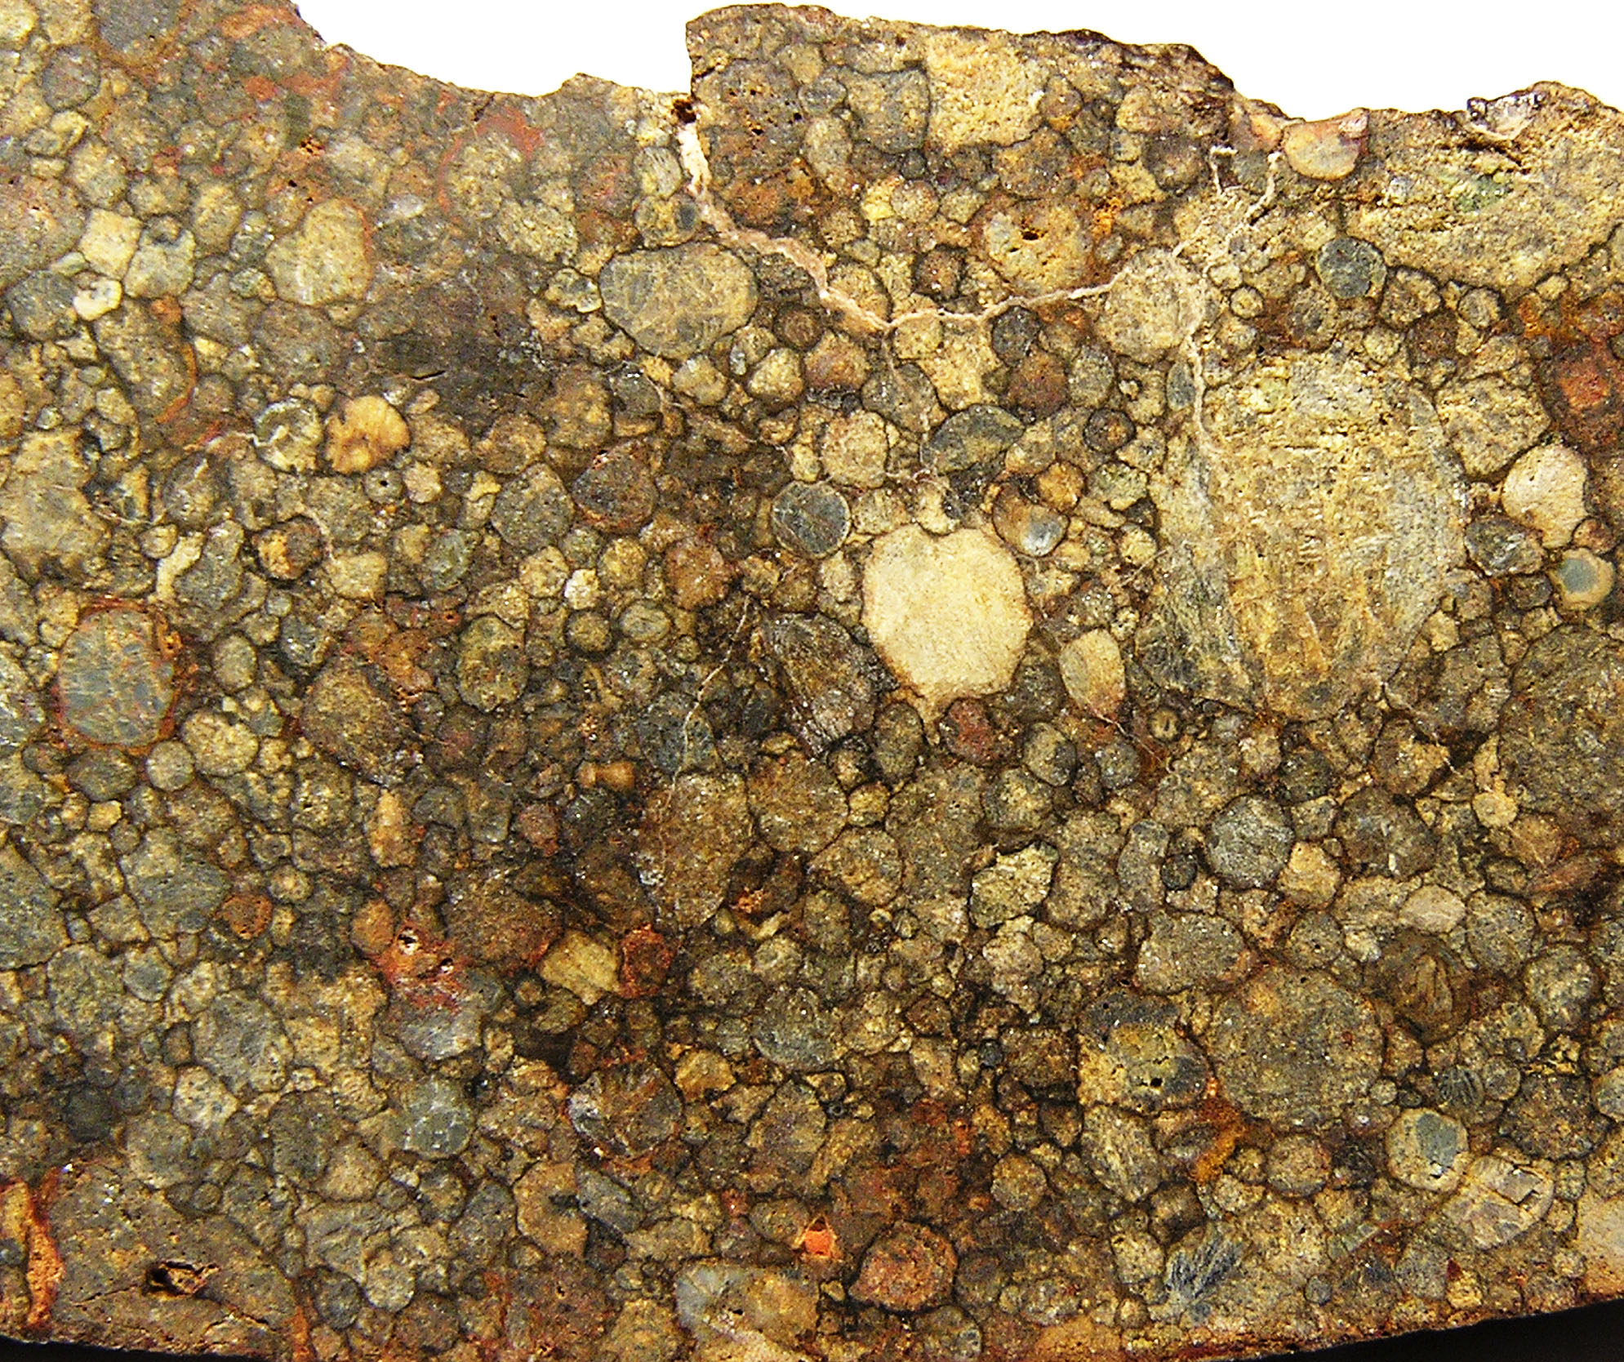
Problem: chondrites are made of sub-mm particles, not 15-60 cm “pebbles”
The streaming instability could happen with chondrule-size particles only if the solid/gas ratio is increased by 8-10 relative to solar (Carrera et al., 2016)

Slide 29
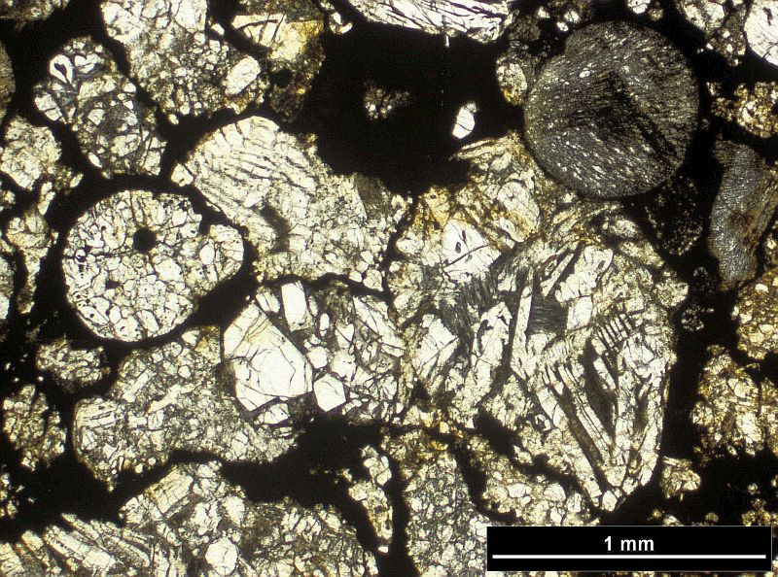
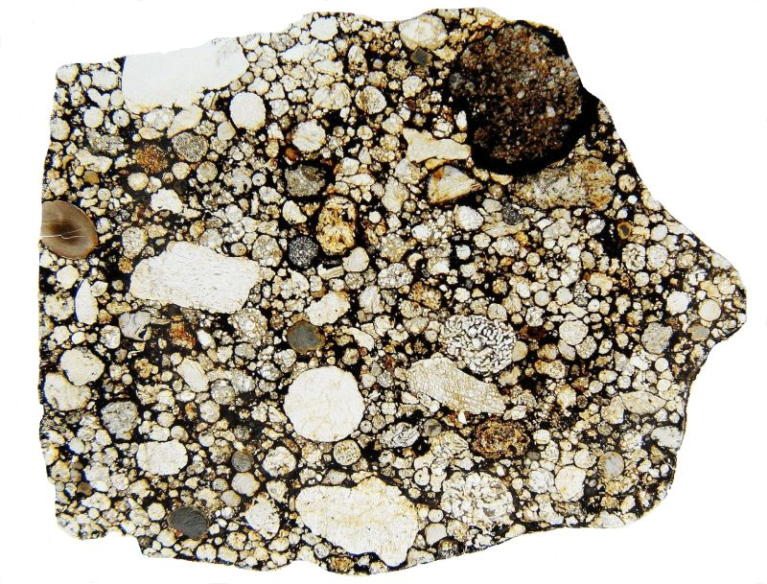
Possibly, in high-density conditions, chondrules can collide with each other, avoid the bouncing barrier by multiple mutual collisions, stick to each other through their dust rims.
This way, they could form macroscopic aggregates, which may behave as previously seen
We do see cm-size chondrule clusters in chondrites!
Metzler et al., 2012

Slide 30
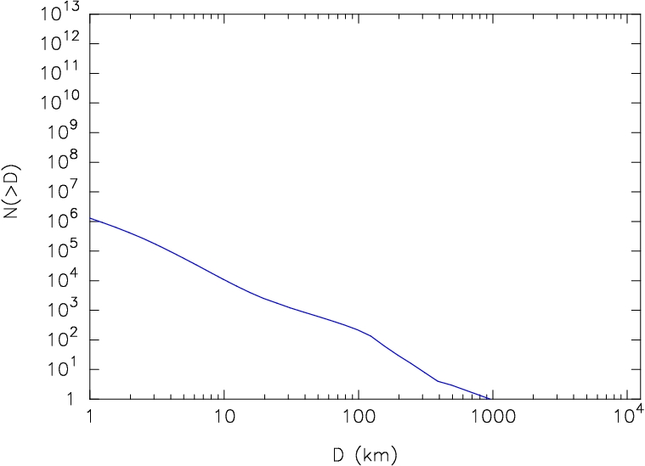
PLANETESIMALS FORMED BIG: ASTEROID AND KUIPER BELT EVIDENCE
Primordial `bump’
Bottke et al. (2005)

Slide 31
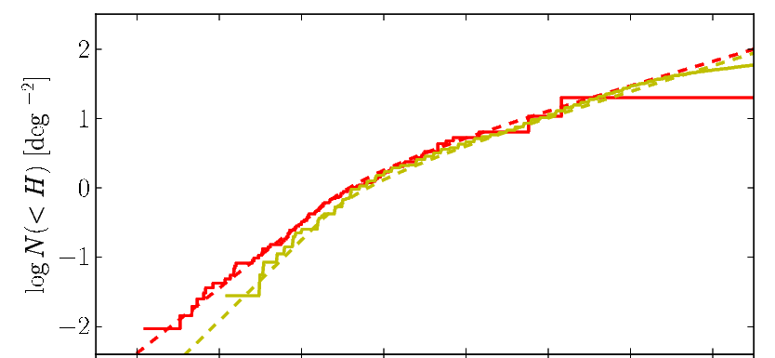
PLANETESIMALS FORMED BIG: ASTEROID AND KUIPER BELT CONSTRAINTS
Primordial `bump’
Fraser et al., 2014

