Slide 1
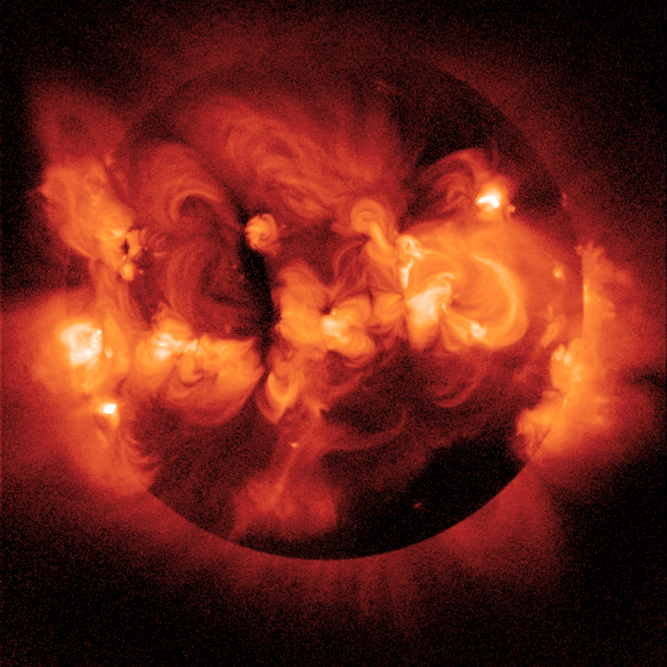
Future Challenges….
Hans Kjeldsen
Aarhus University, Denmark

Slide 2
Stellar Variability
Minutes/hours: Oscillations, Eruptions in active regions, granulation

Slide 3
S. Mathur et al.: Solar-like oscillations in KIC 11395018 and KIC 11234888
from 8 months of Kepler data

Slide 4
Stellar Variability
Minutes/hours: Oscillations, Eruptions in active regions, granulation
Days/months: Rotation, Spots, damping and excitation of oscillations

Slide 5
540 d, mag: 8.74
F main sequence
Kepler

Slide 6
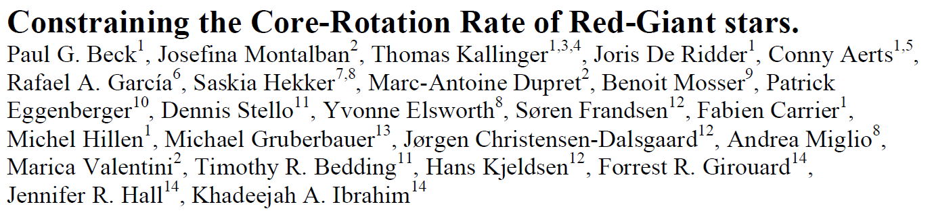
… we report the detection of non-rigid rotation in the interiors of red-giant
stars using light curves obtained by the Kepler spacecraft. We exploit
rotational splittings of the recently detected mixed modes, to demonstrate
an increasing rotation rate from the surface of the star to the stellar core.
Comparing with theoretically predicted rotational splittings, we established
that the core must rotate at least ten times faster than the surface.

Slide 8
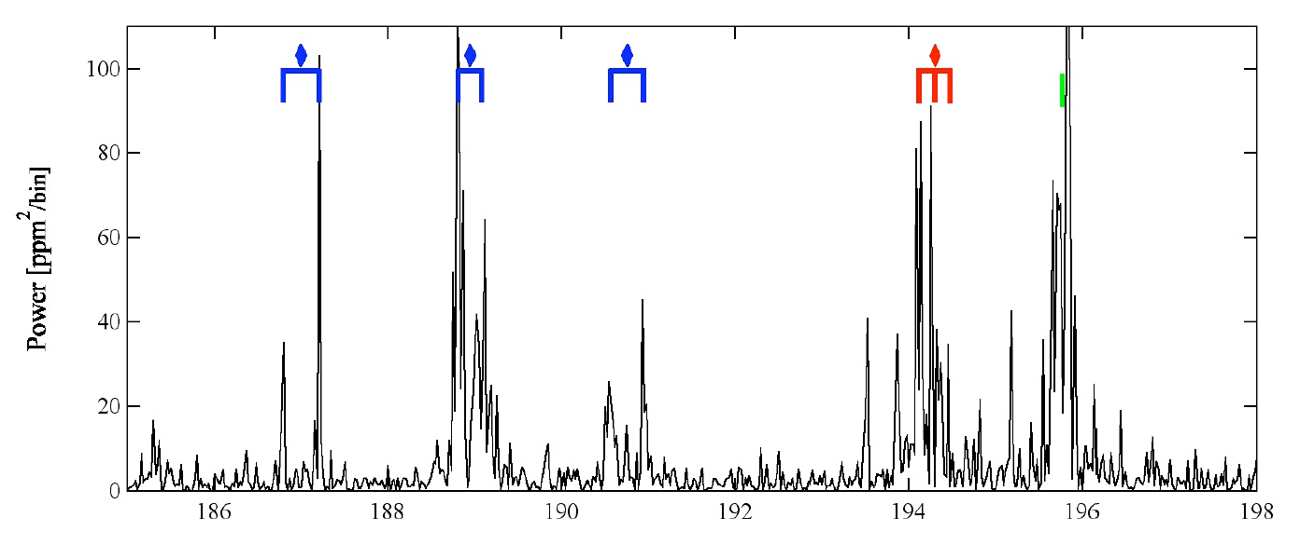

Slide 9
Stellar Variability
Minutes/hours: Oscillations, Eruptions in active regions, granulation
Days/months: Rotation, Spots, damping and excitation of oscillations
Years: Activity cycles

Slide 10
Stellar Variability
Minutes/hours: Oscillations, Eruptions in active regions, granulation
Days/months: Rotation, Spots, damping and excitation of oscillations
Years: Activity cycles
Millions and Billions of years: Structure and composition

Slide 11
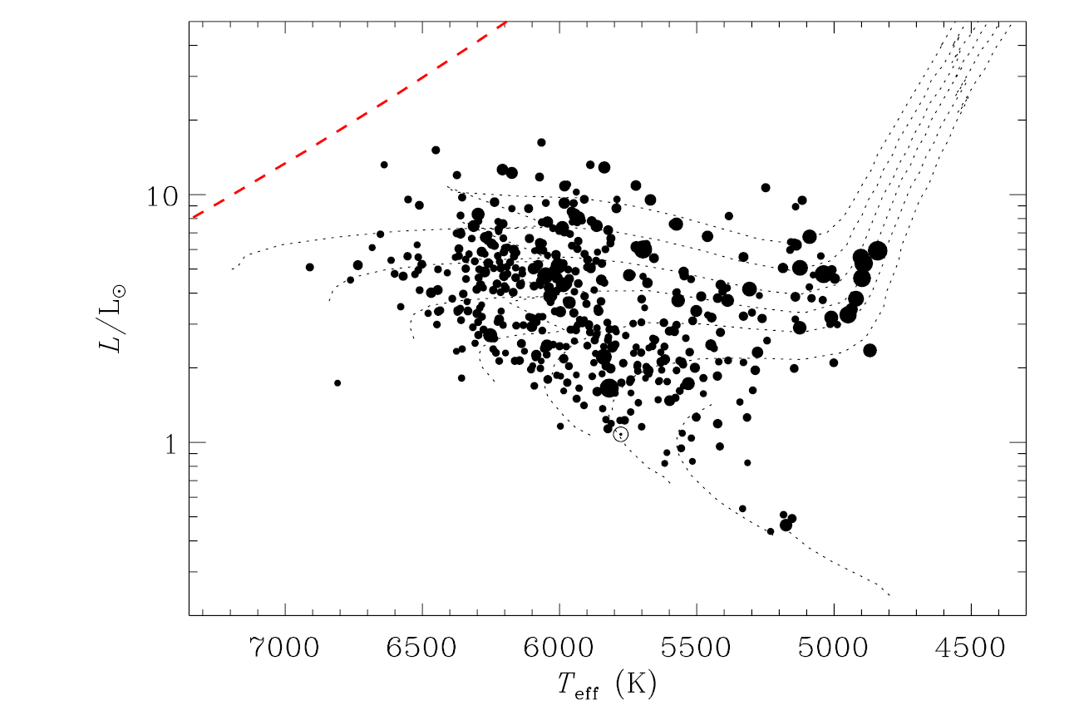
Chaplin et al. 2011

Slide 16
450 d, mag: 7.18
G main sequence
Kepler

Slide 17
540 d, mag: 9.27
subgiant
p-modes
g-modes
Kepler

Slide 18
Stellar evolution

Slide 21
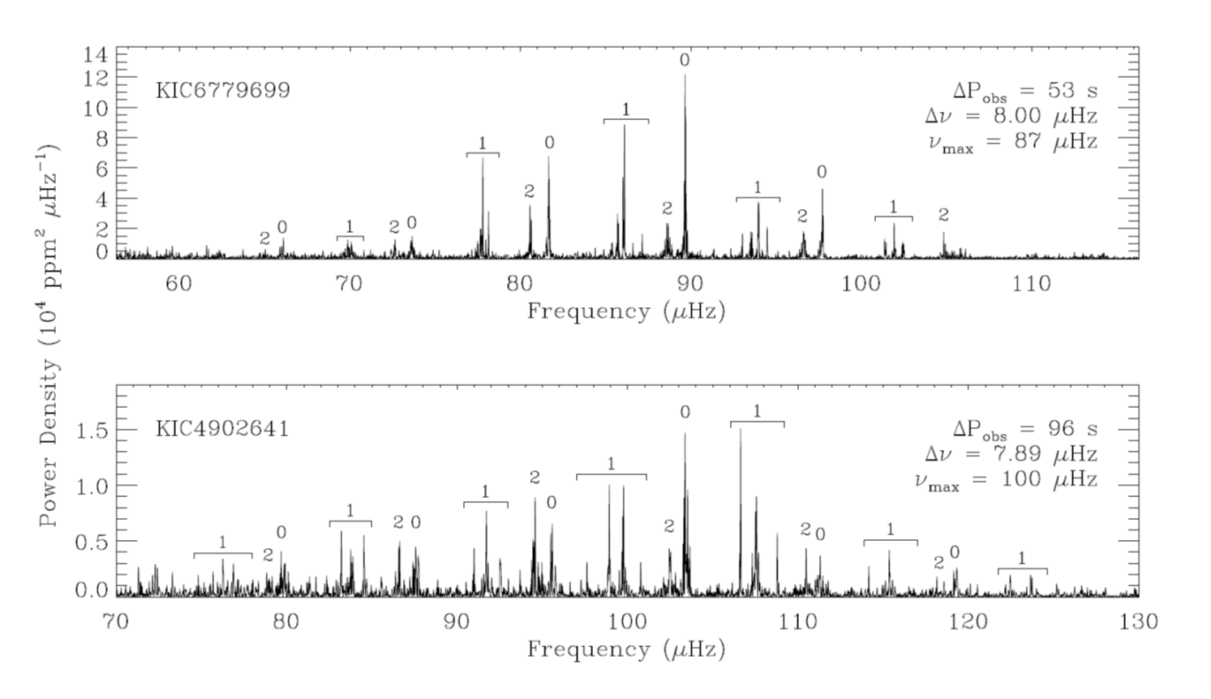


Slide 22
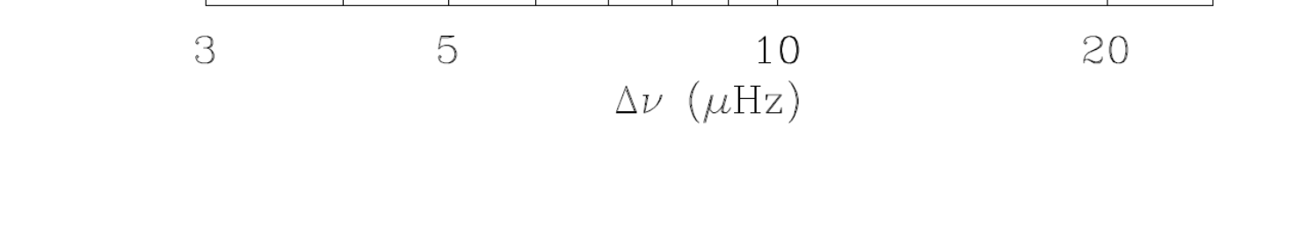

Slide 23
Observational Asteroseismology:
Observables
Oscillation frequencies and frequency differences/ratios/splittings
Oscillation mode identification (degree, order and mode type; g/p/f, mixed)
Oscillation mode properties (amplitude, amplitude ratios, phase, phase differences, life time, …)
Changes (short term and long term) in mode parameters (frequencies, amplitudes, …)

Slide 24
Requirements for Observational Asteroseismology:
High-precision time series photometry with high duty cycle

Slide 25
Following Montgomery and D. O’Donoghue, 1999

Slide 26
Following Montgomery and D. O’Donoghue, 1999

Slide 27
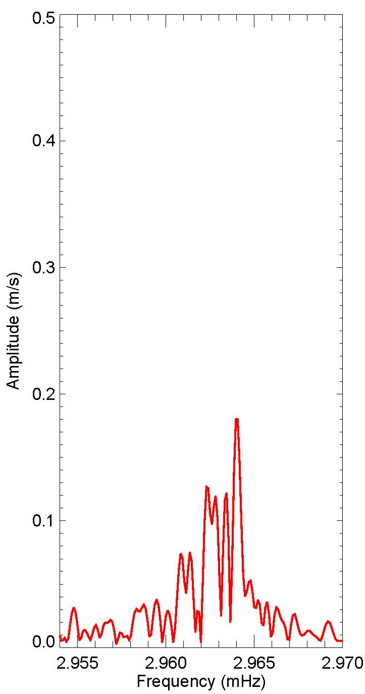
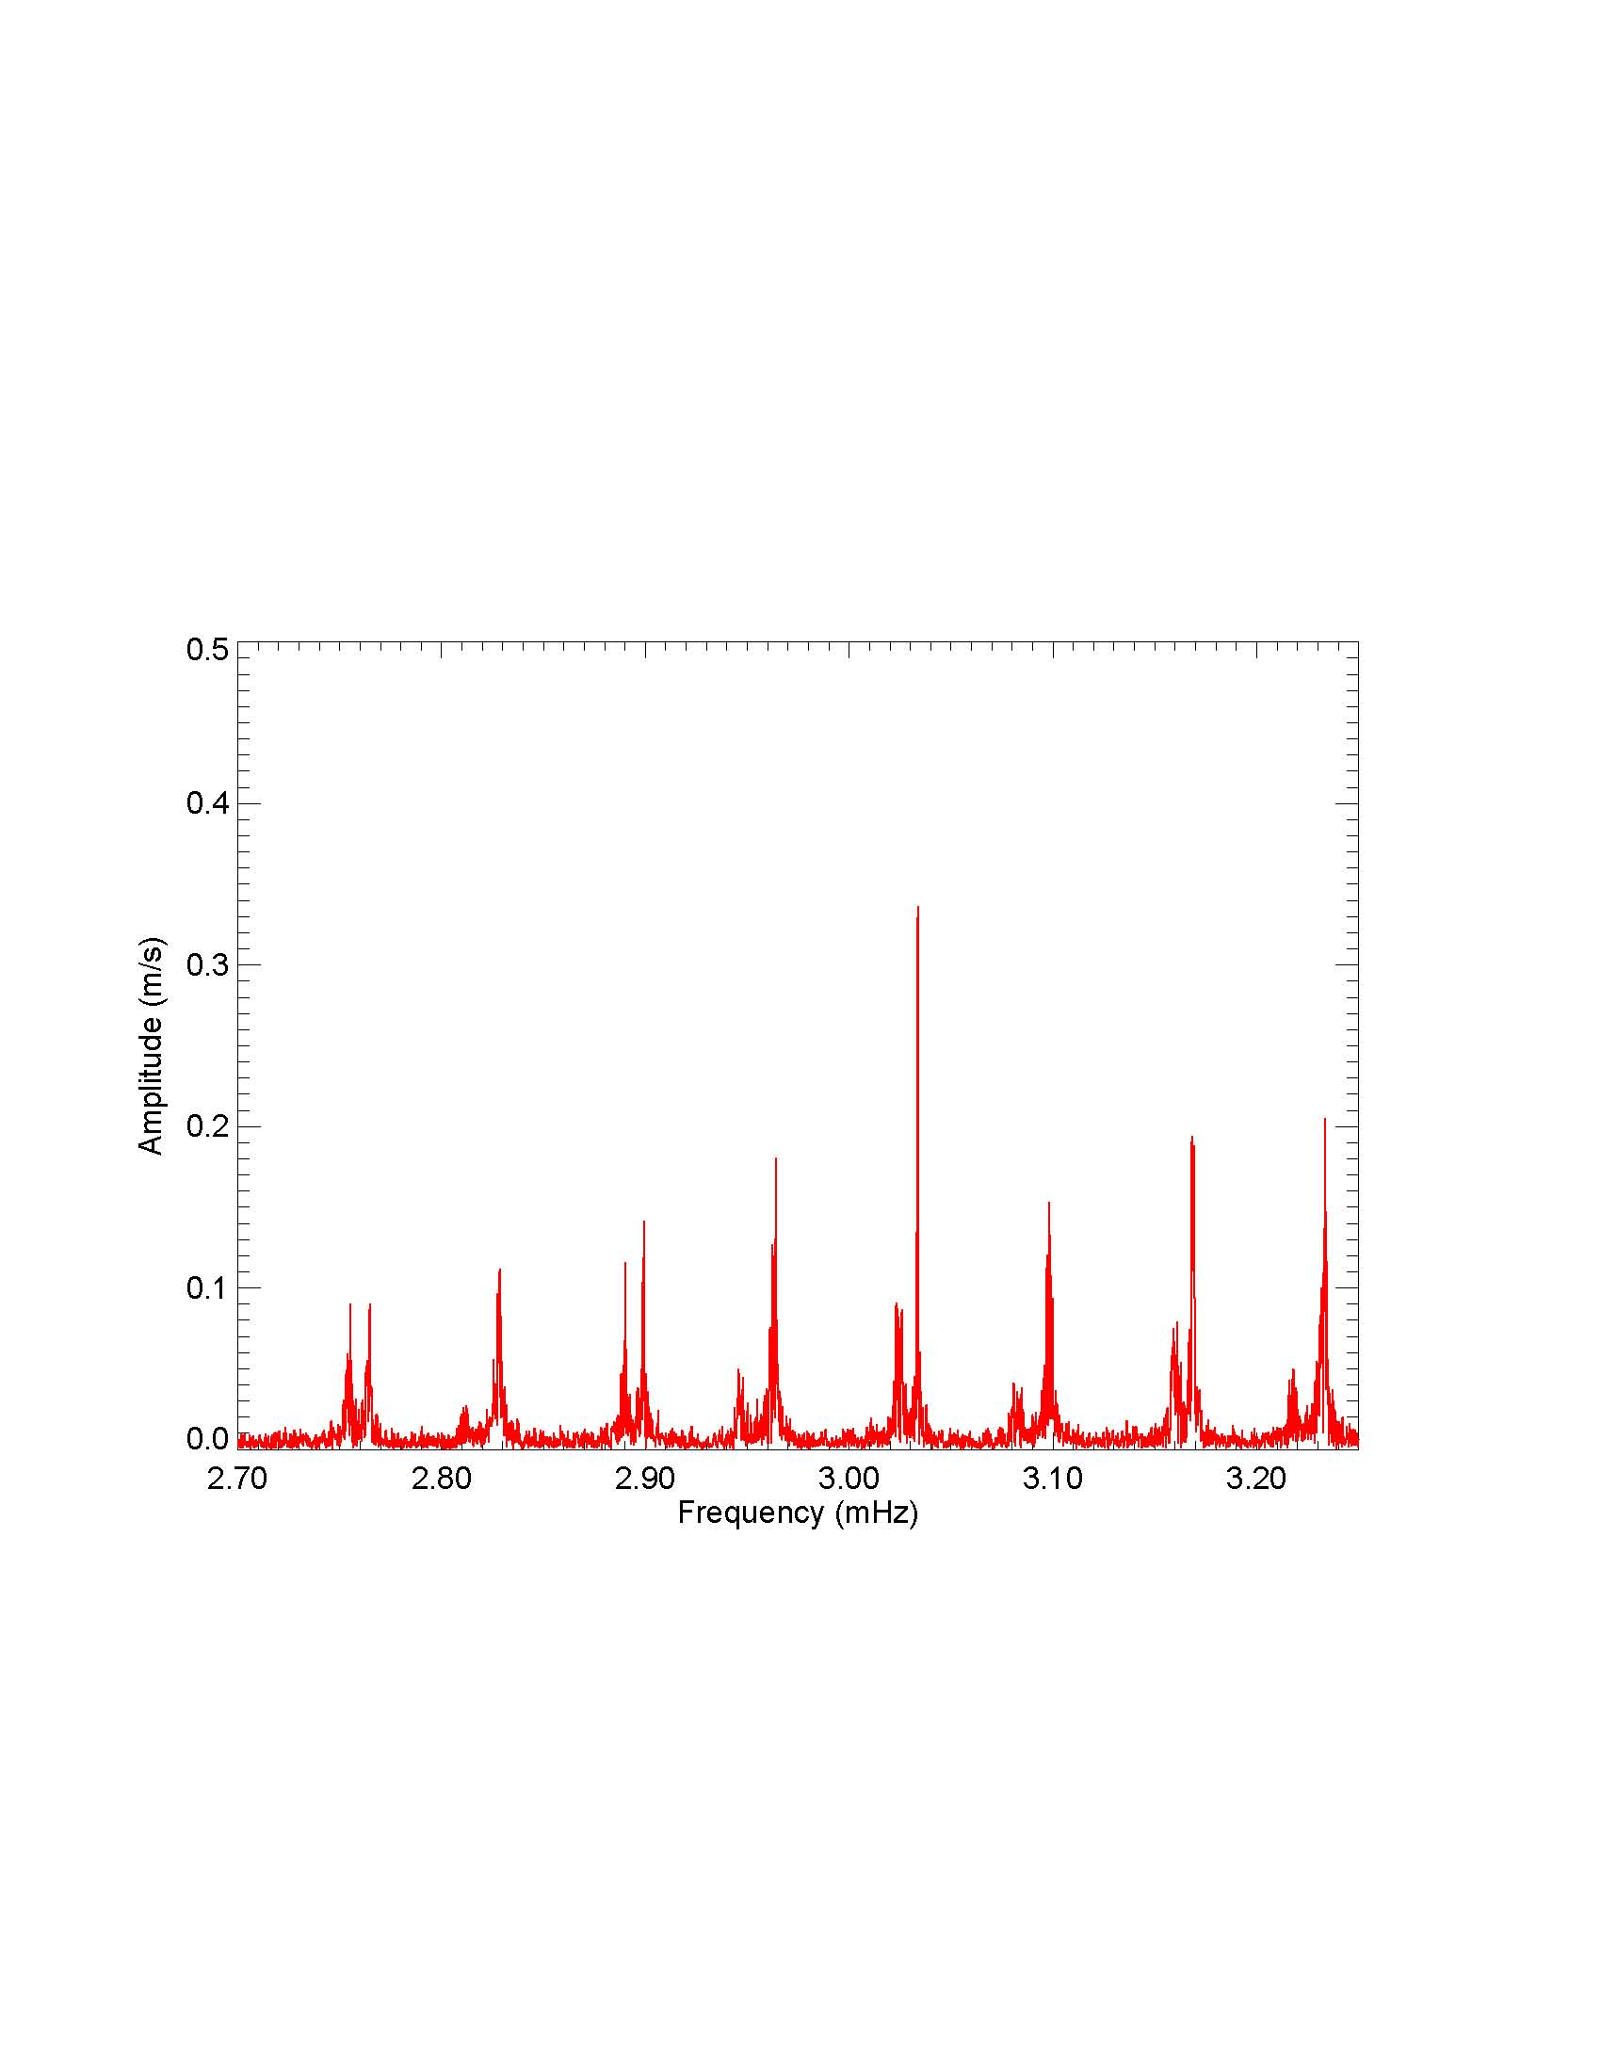
p-mode oscillations:
Mode life-time (Damping)

Slide 28
Coherent modes
Damped and re-excited modes

Slide 29
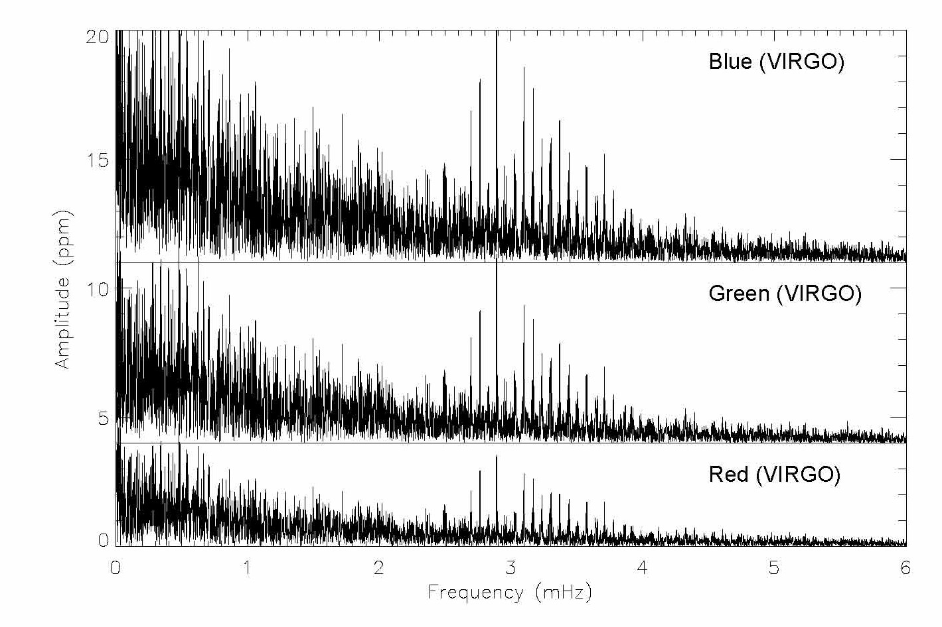
5 d

Slide 30
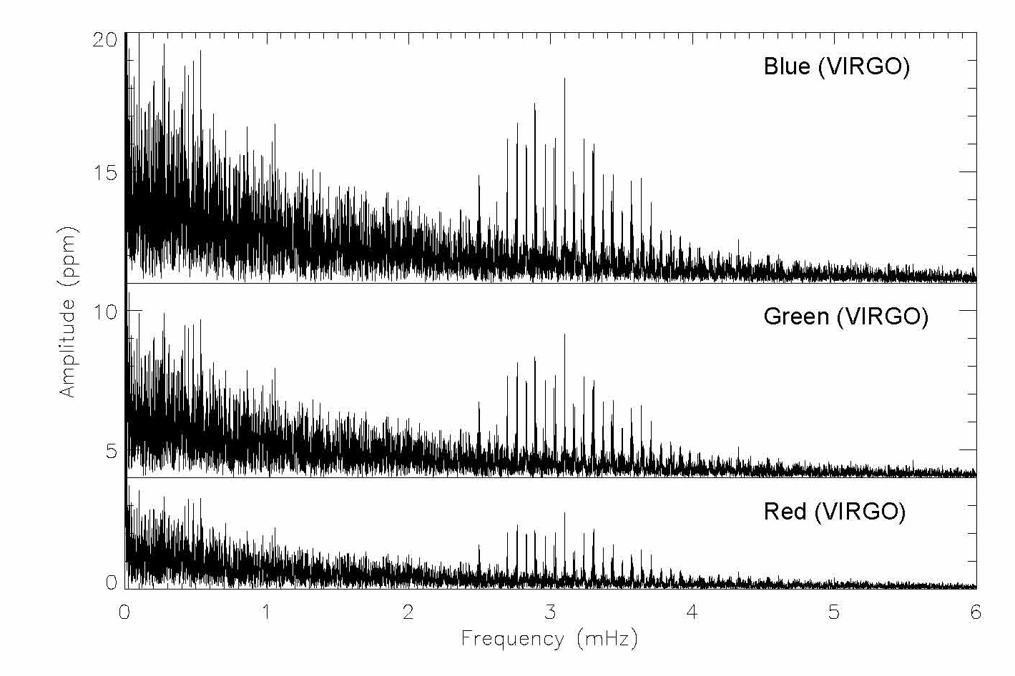
10 d

Slide 31
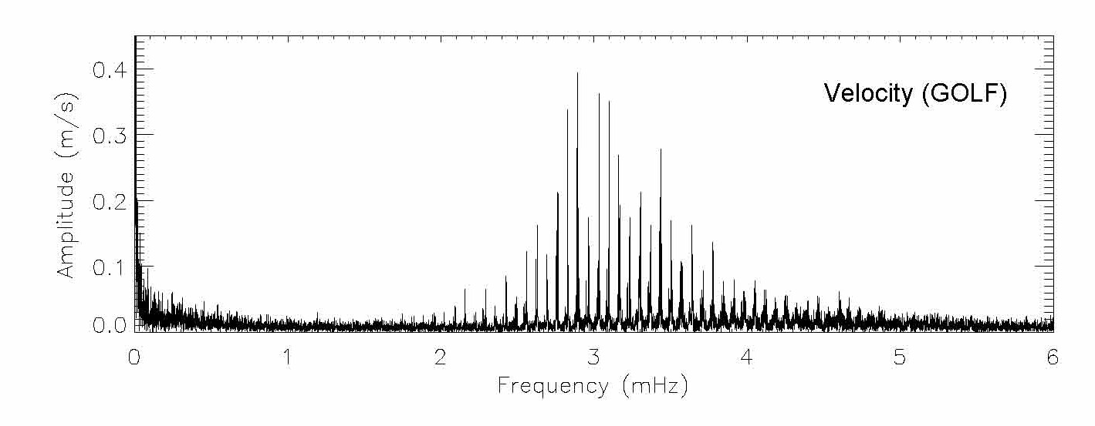
10 d

Slide 32
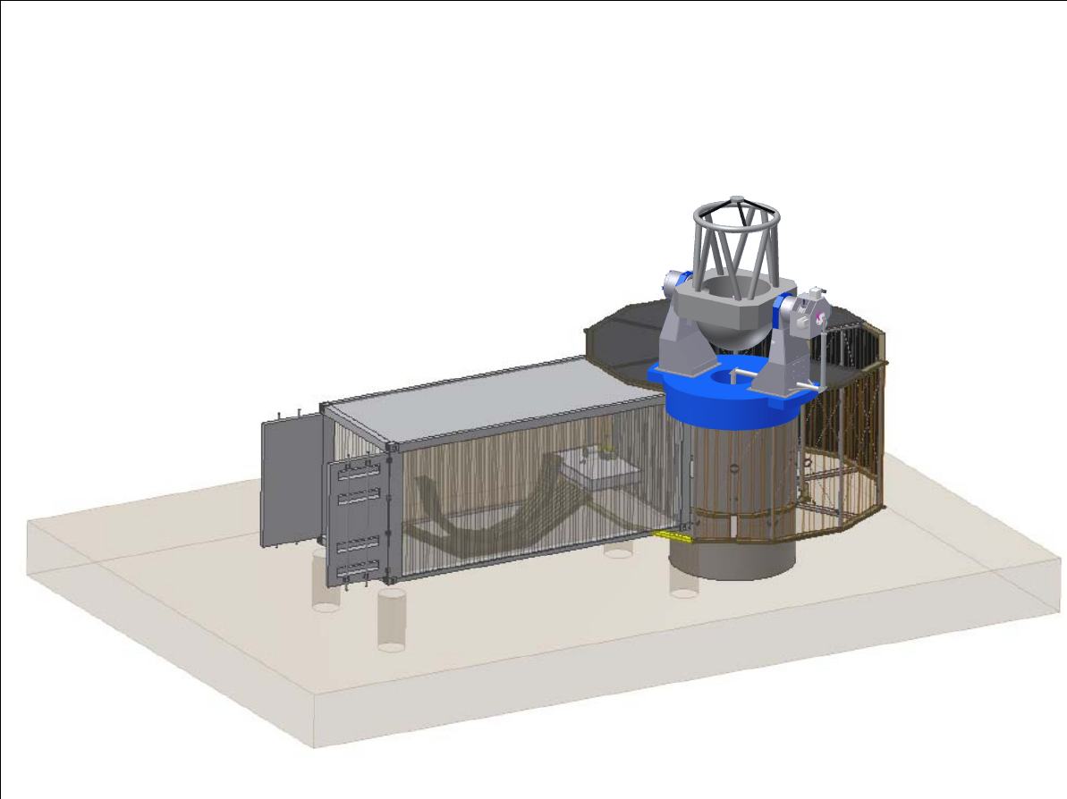
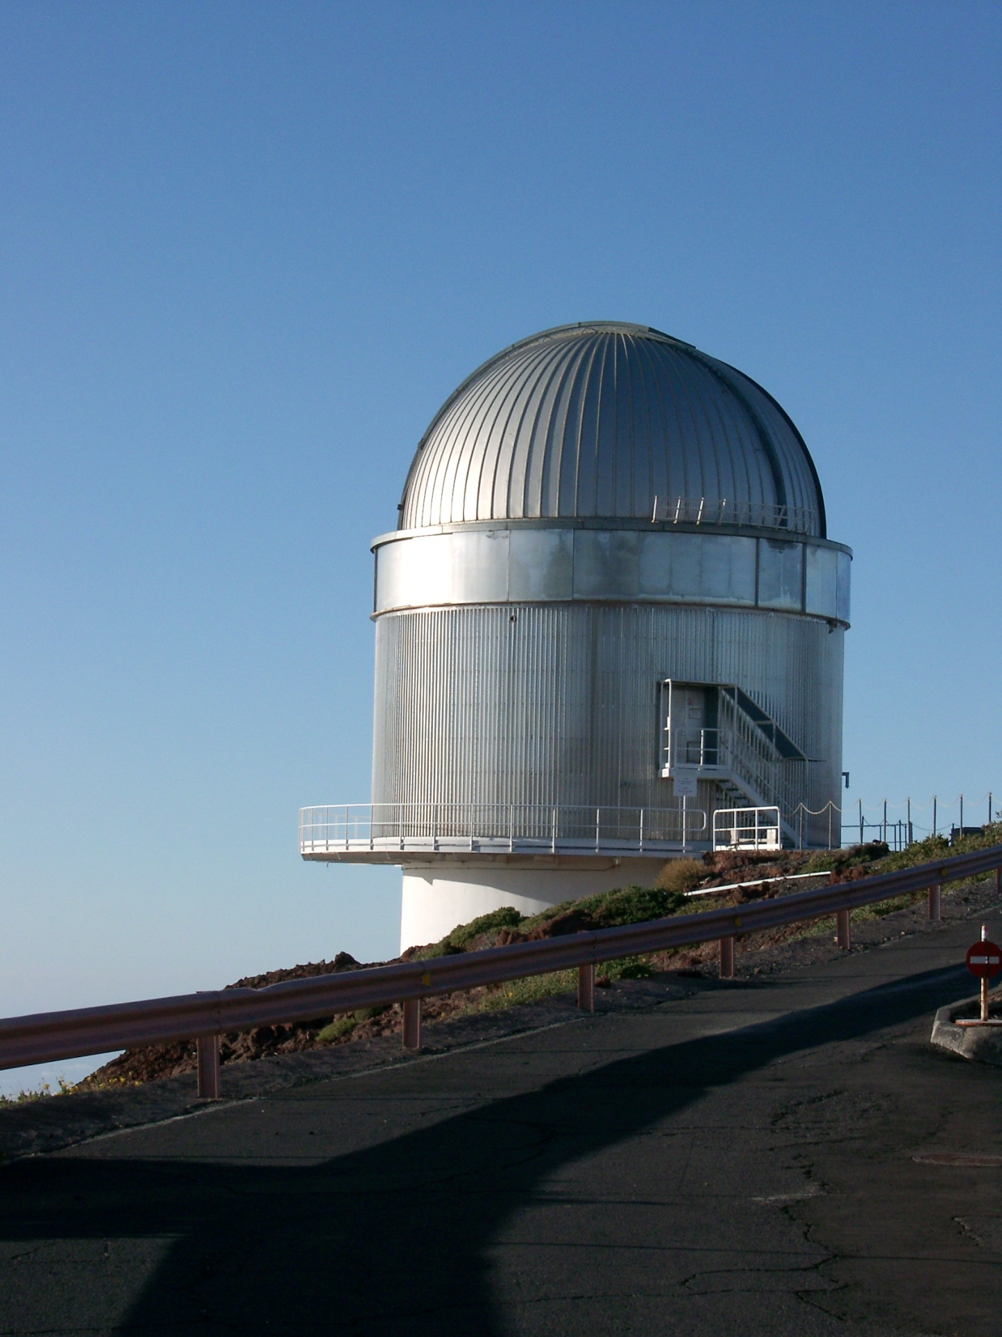
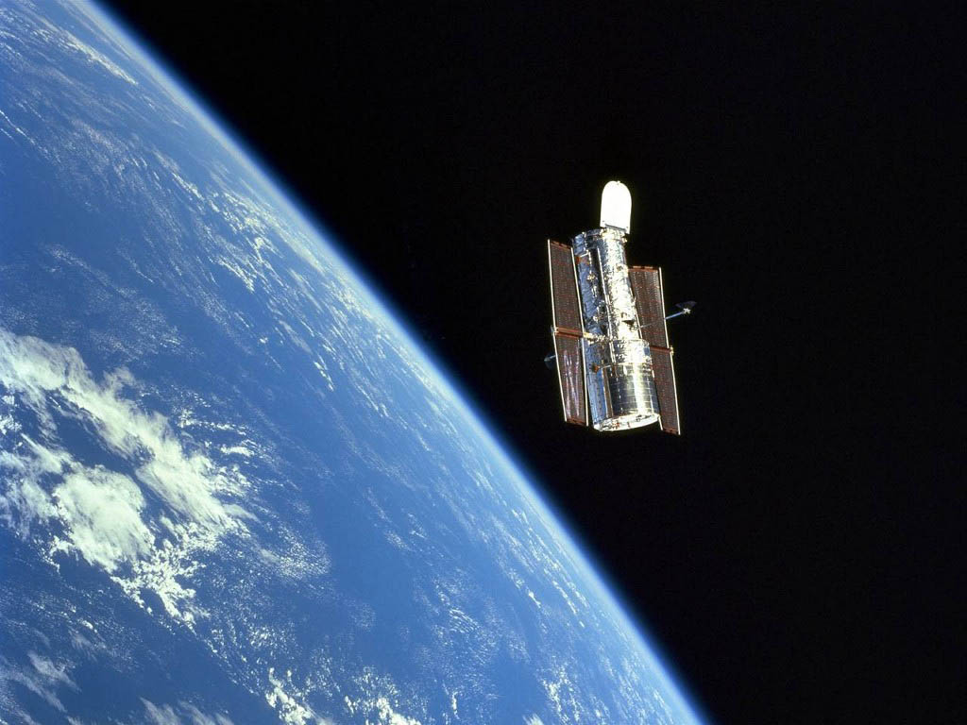
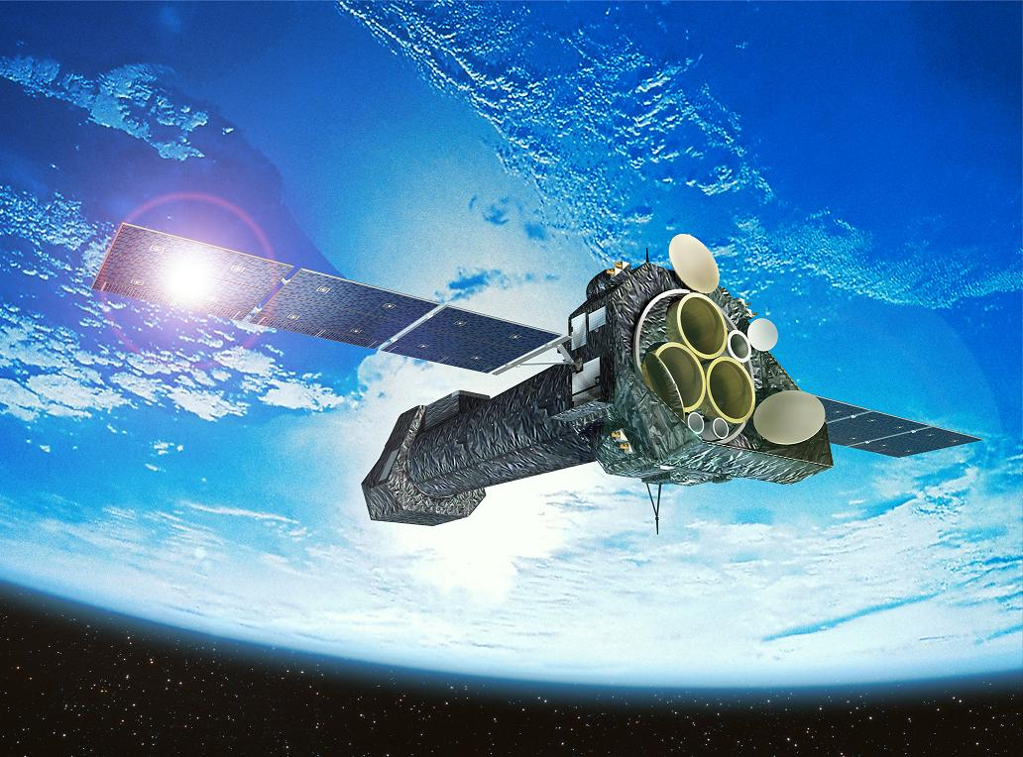
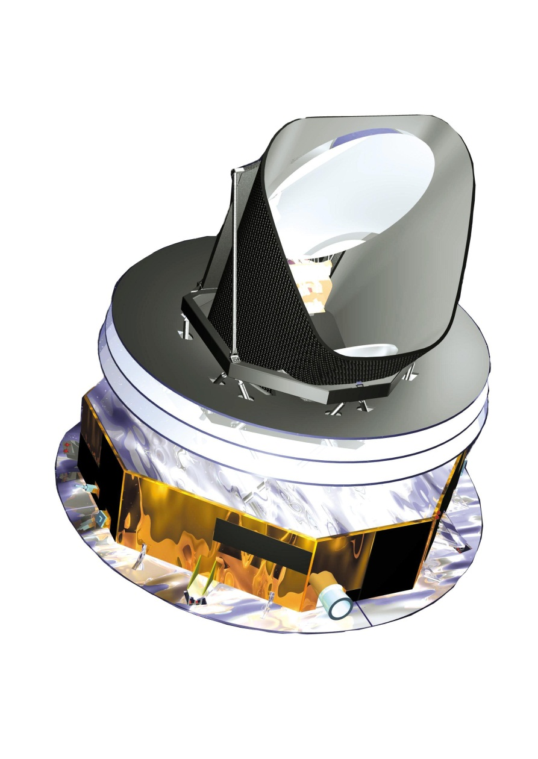
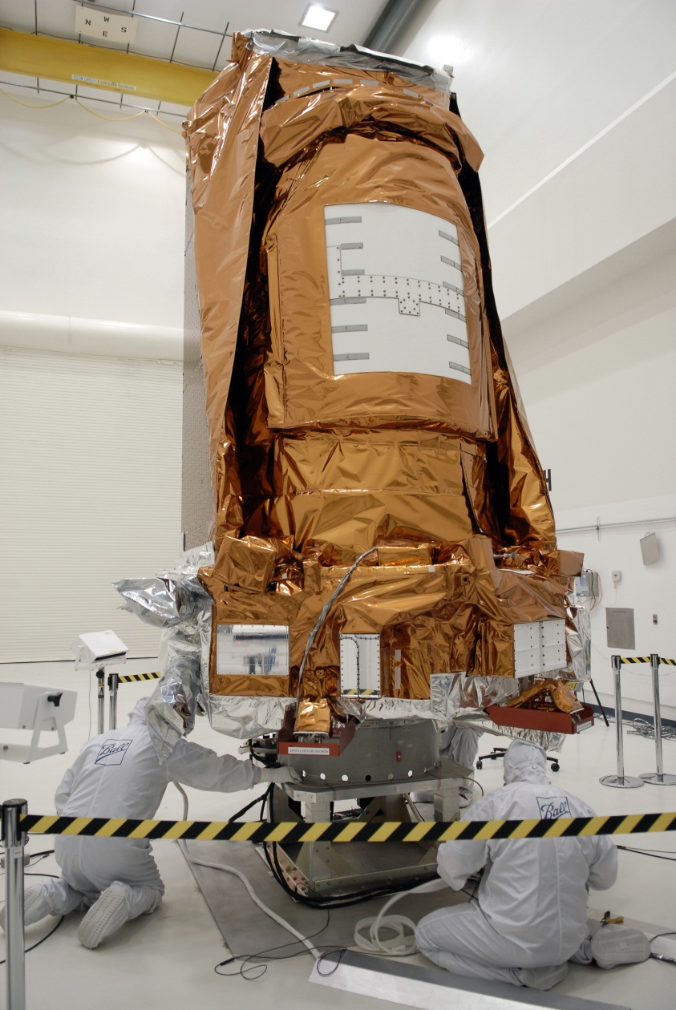

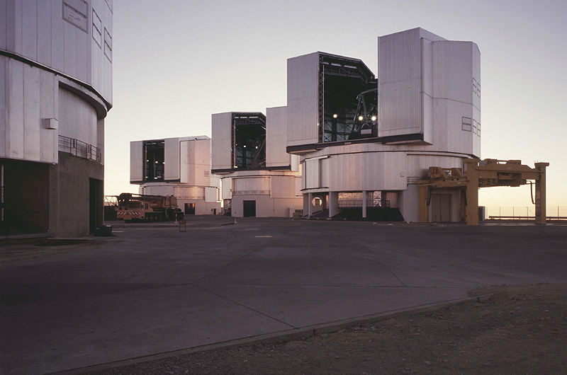

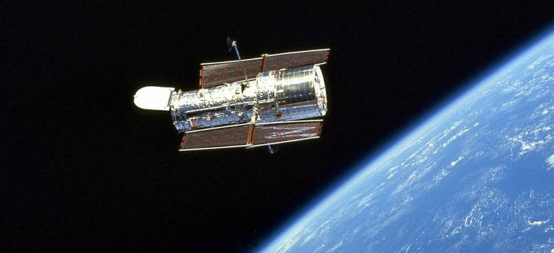
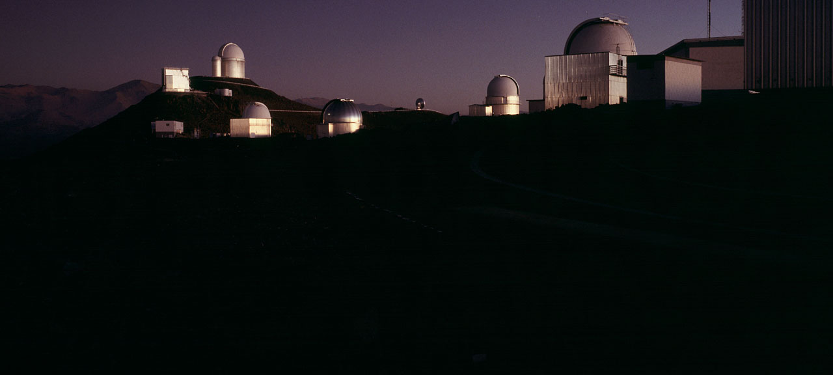

Slide 33
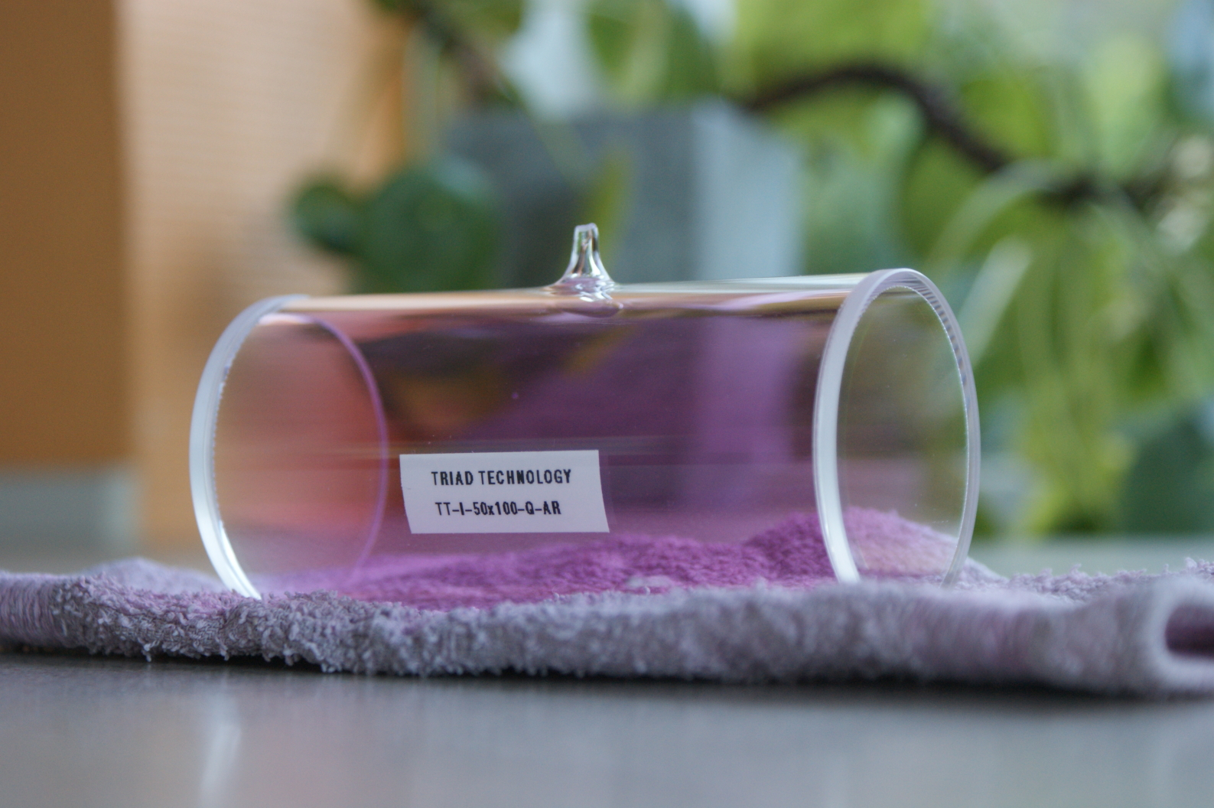

Slide 34
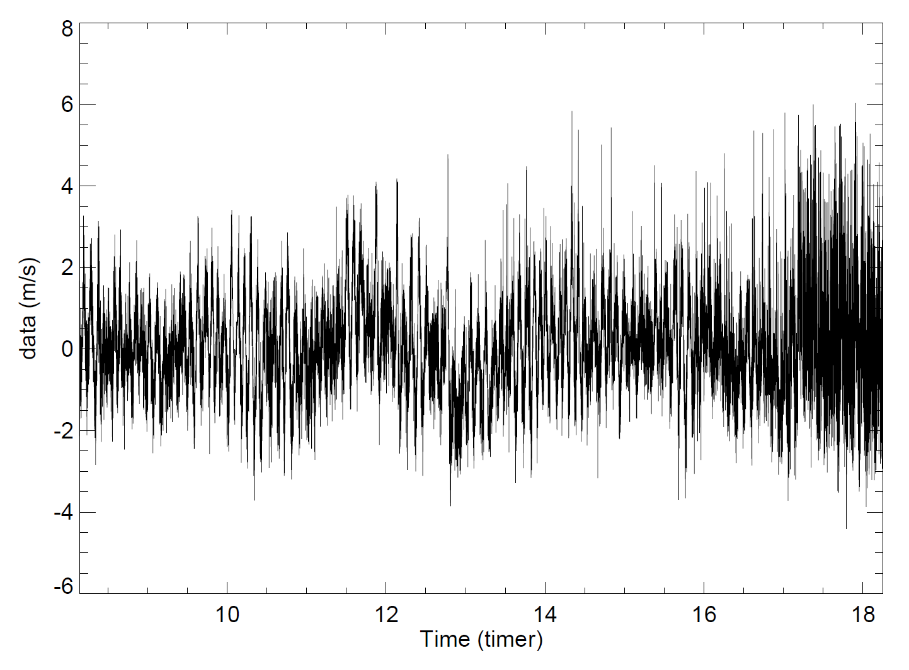

Slide 35
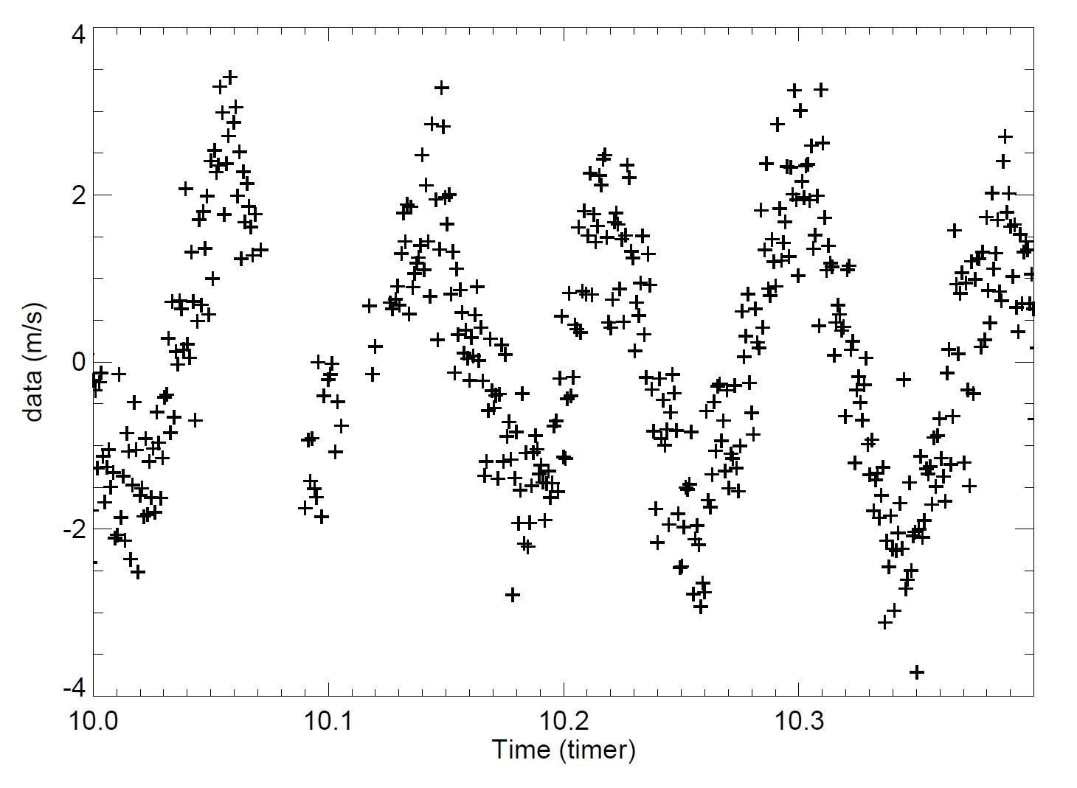

Slide 36
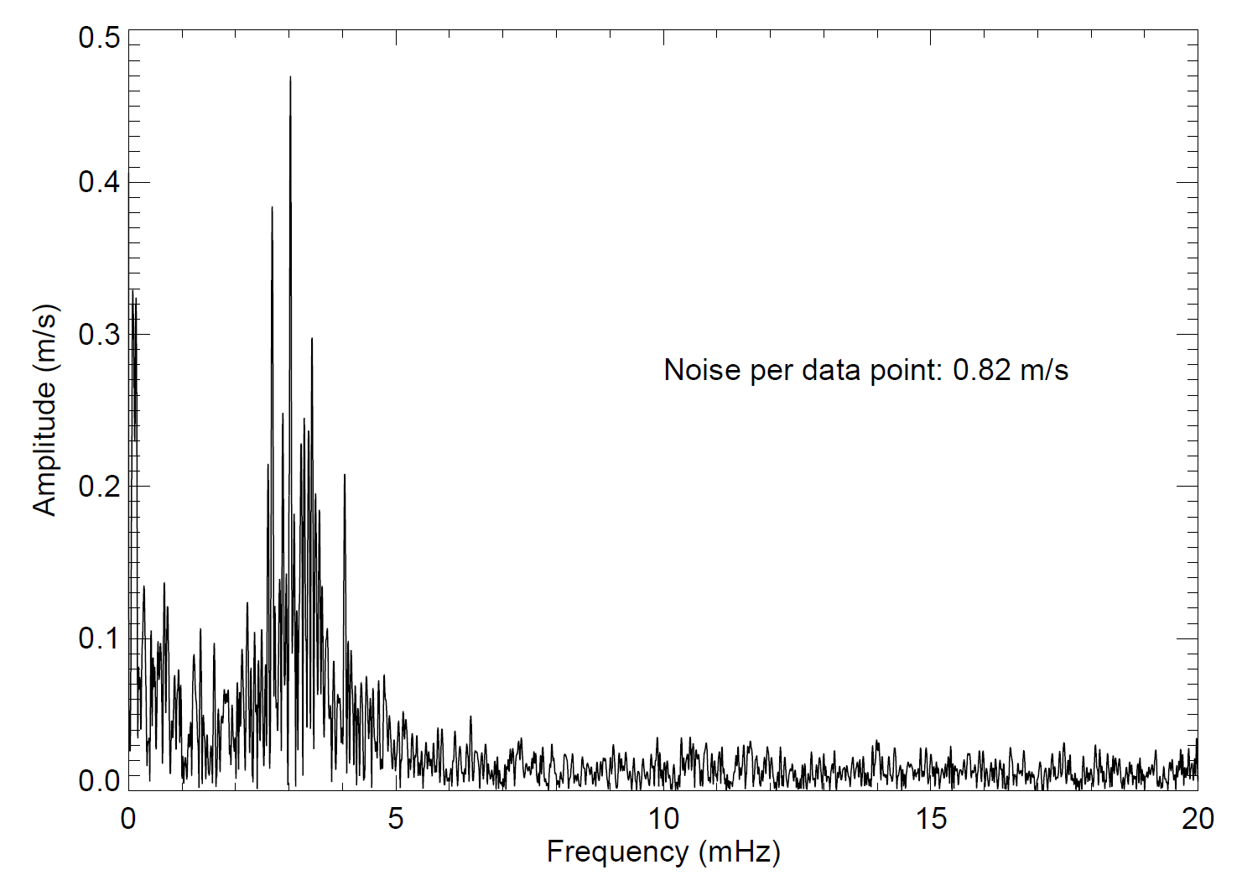

Slide 37
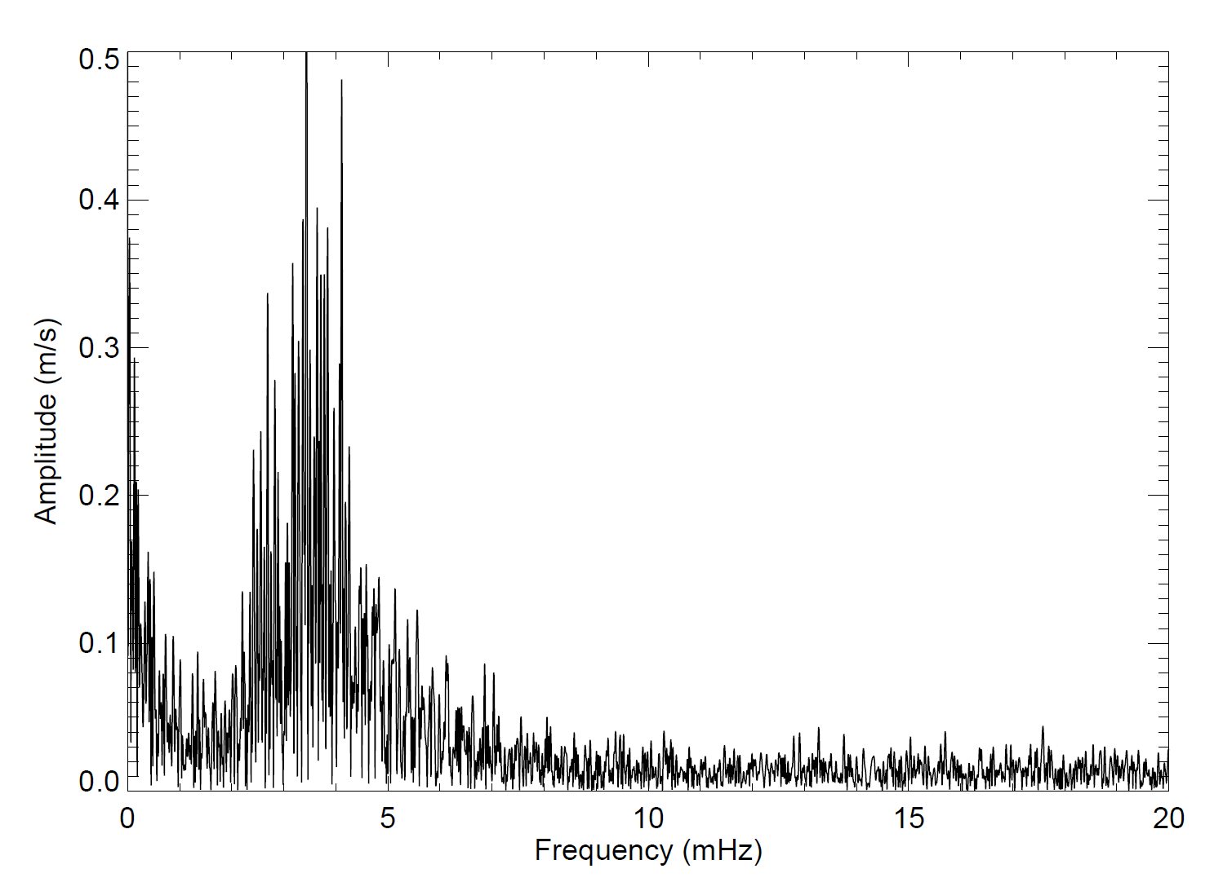
SoHO / GOLF

Slide 39
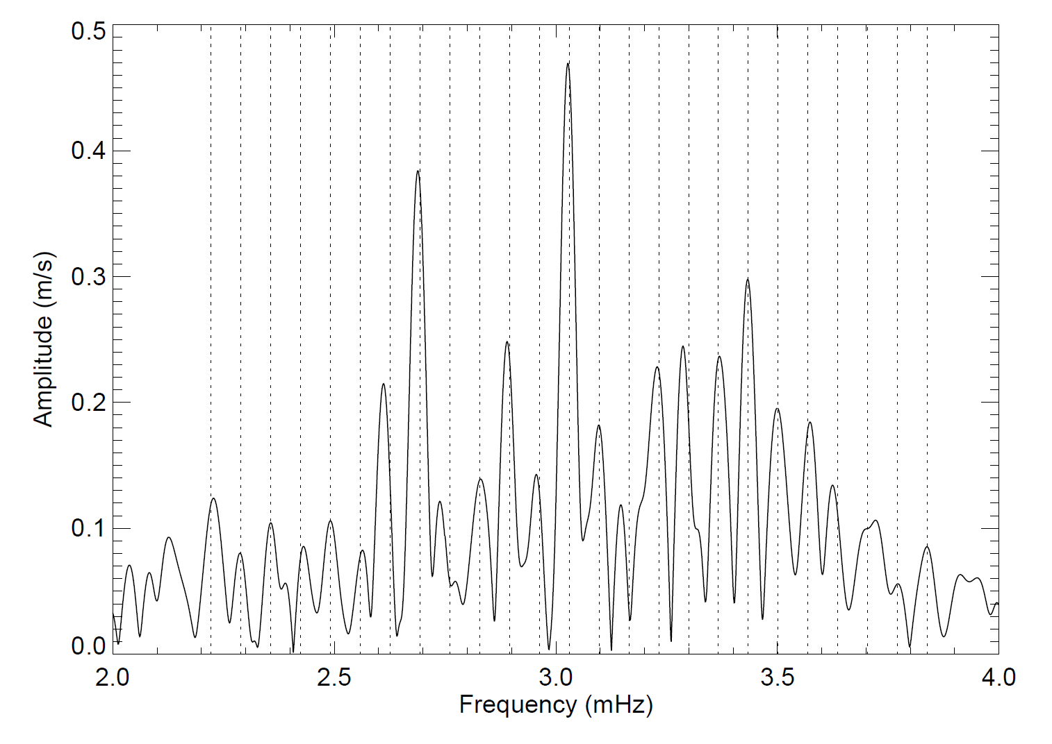

Slide 40
Requirements:
High-precision time series photometry with high duty cycle
Space:
High Photometric Precision due to no atmospheric effects (scintillation)
Long uninterrupted time series (high duty cycle, extended observation)
Large number of targets observed (large FOV, high density of stars)

Slide 41
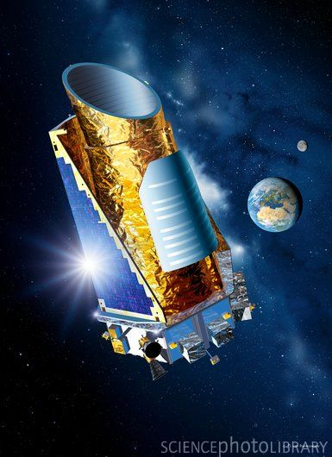
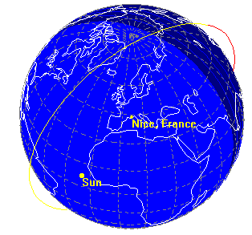
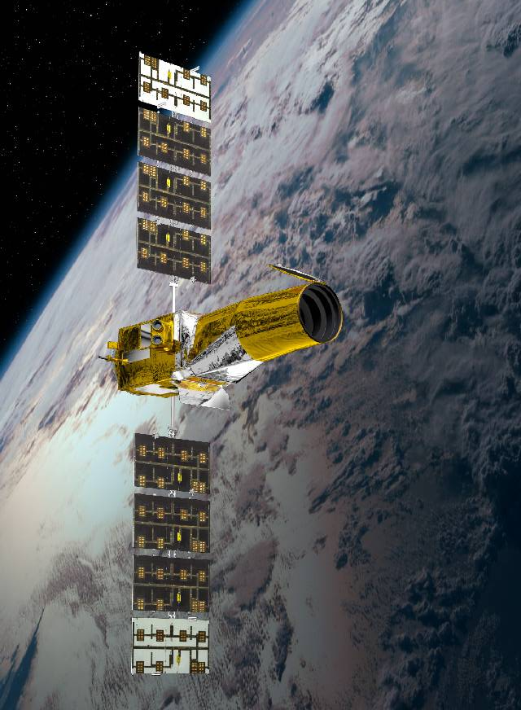
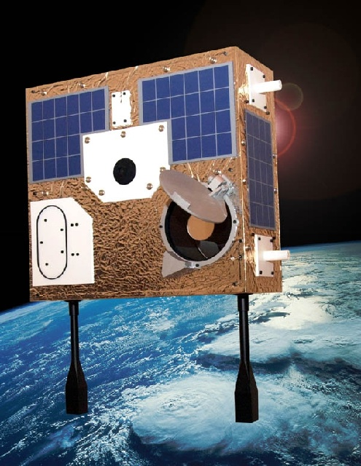
CoRoT and MOST
Low Earth Orbit (LEO)
Several pointings
Kepler Orbit
Earth trailing Heliocentric
One FOV for whole mission

Slide 42
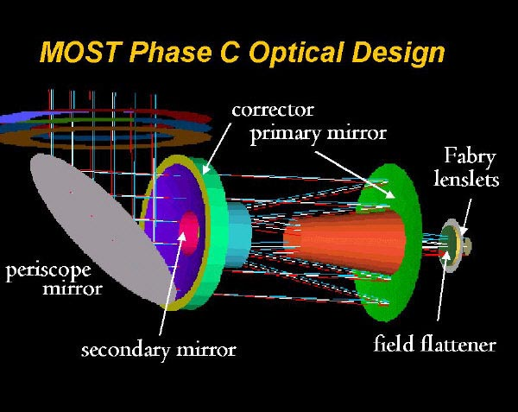
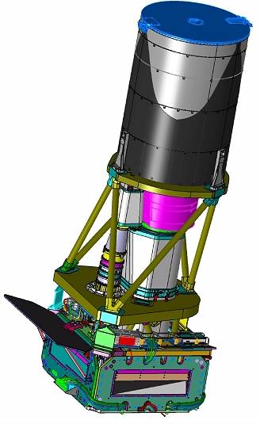
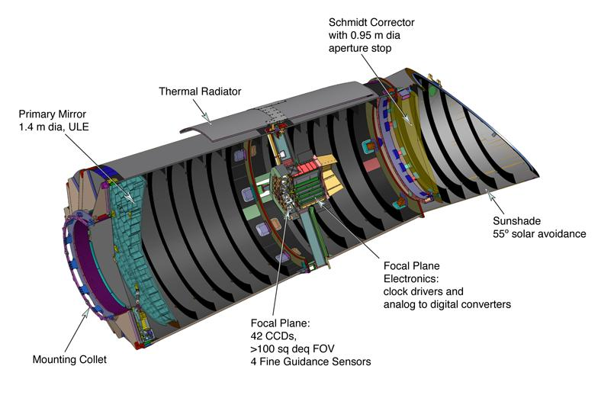
MOST (CSA): 15 cm
CoRoT (CNES): 27 cm
Kepler (NASA): 95 cm

Slide 43
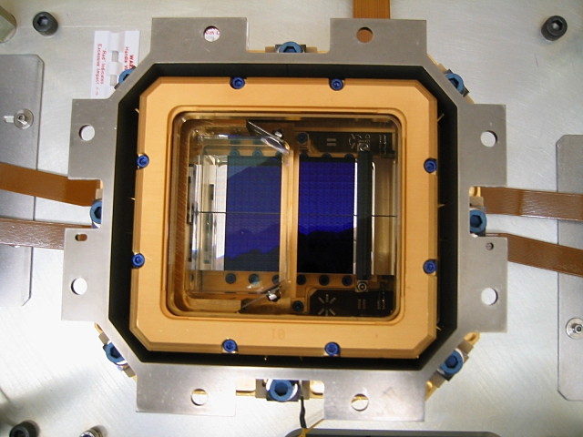
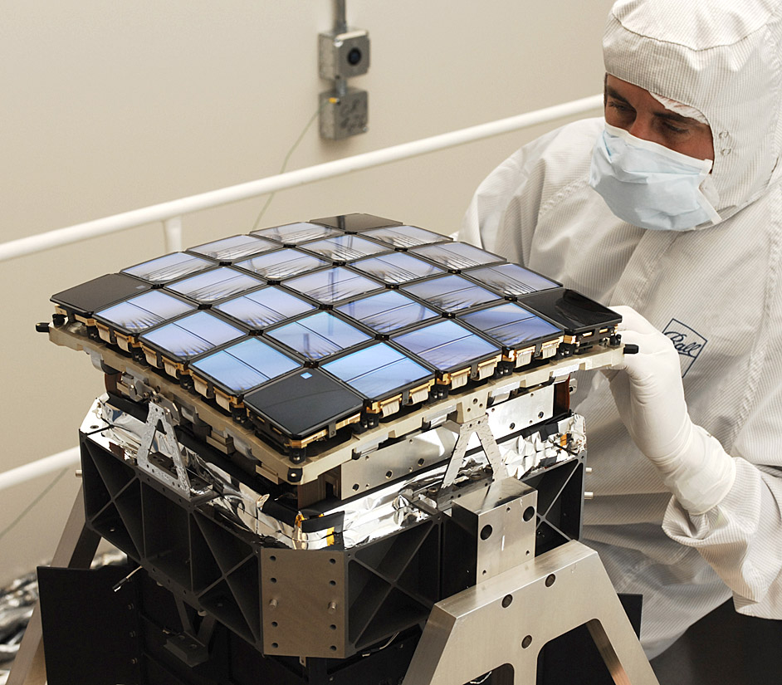
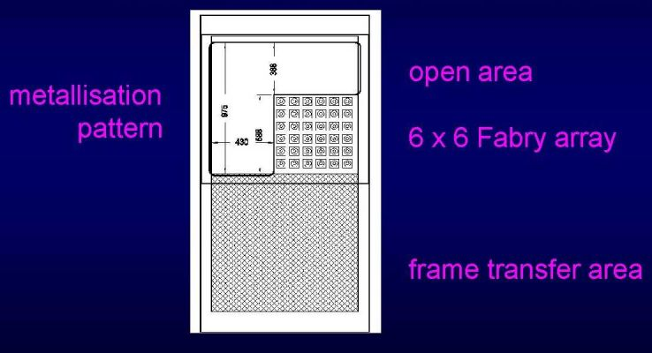
CoRoT: 4 CCD’s
Kepler: 42 CCD’s
MOST: 1 CCD

Slide 44
The three Space Missions
MOST: Precursor for dedicated time series missions. Focus is on bright stars.
CoRoT: More than 100,000 targets for exoplanet studies ( T(obs) < 180d ). Few hundred stars observed for asteroseismology.
Kepler: Very extended time series data (years). Relatively low crowding effects. High dynamical range (V: 7-16)

Slide 45
The data …
Jenkins et al. 2010
Kepler

Slide 46

Can the data meet the challenges?
…. a series of examples …
$${10}^{14}$$
Kepler

Slide 47
Noise levels
Magnitude 7: 15 ppm / min
2.8 ppm / 30-min
0.40 ppm / day
0.04 ppm / Q (90-d)
Amplitude Spectrum Noise (90-d):
0.08 ppm

Slide 48
Stellar evolution

Slide 49
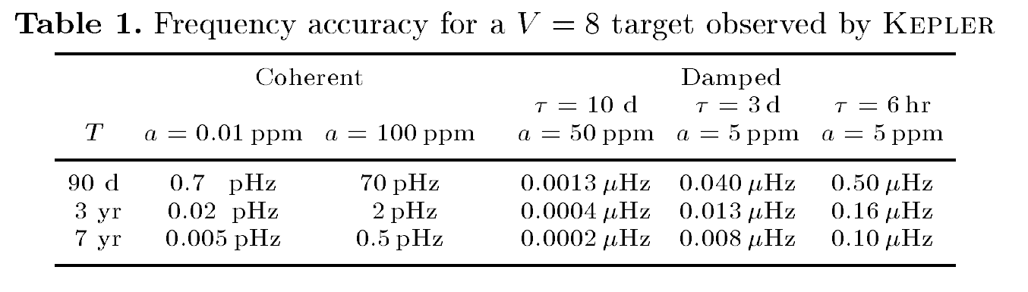
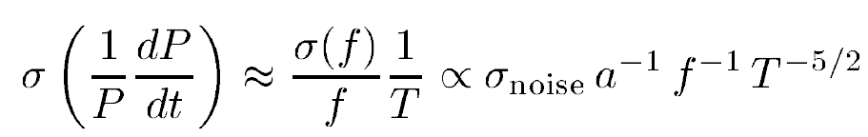

Slide 50

Extended time series data
High duty cycle
High SNR (radial vel.)
Follow-up on ground
Many targets
Models

Slide 51
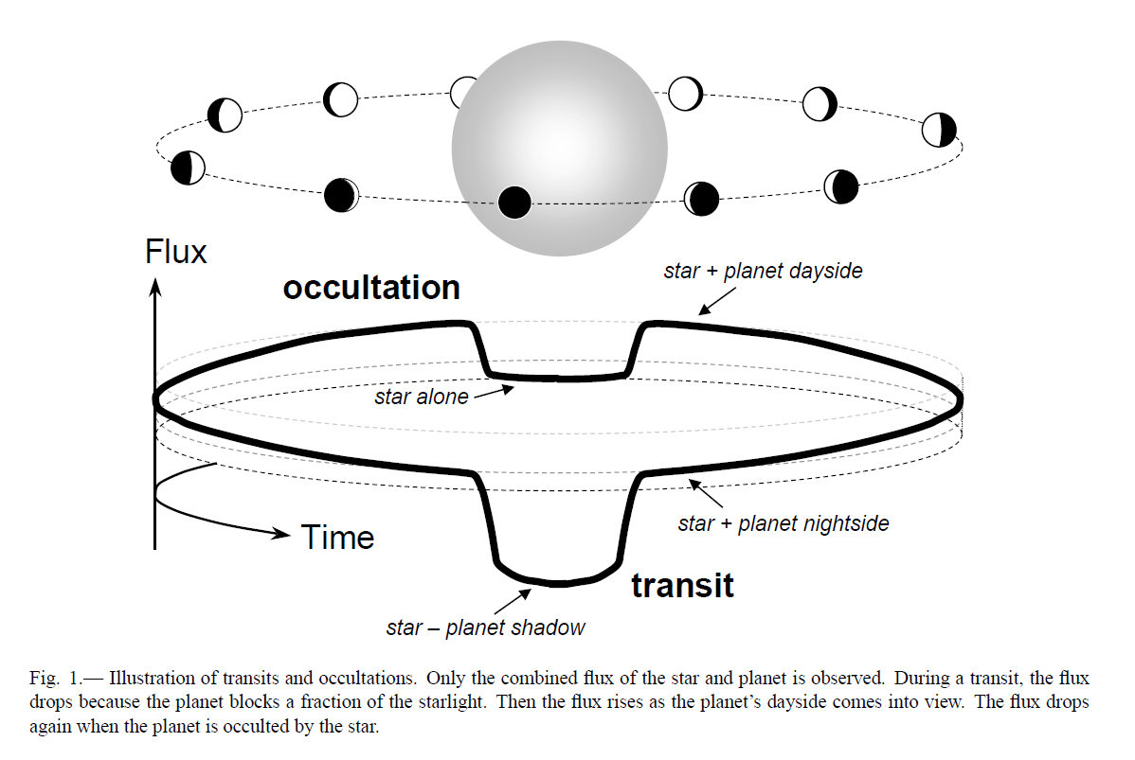
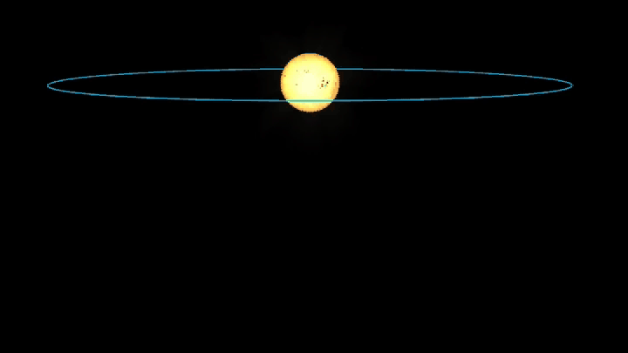

Slide 52
HAT-P-7
HAT-P-7
Nielsen et al. 2012

Slide 53
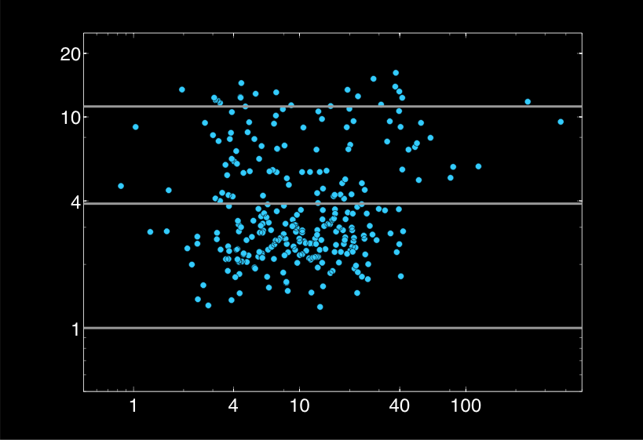
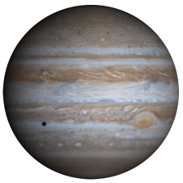
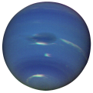

Kepler Exoplanet Candidates – June 2010
Radius relative to Earth
312
Period (d)

Slide 54
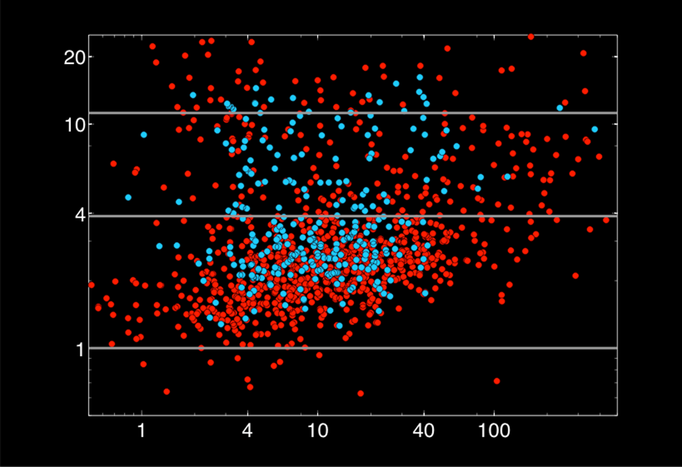
Kepler Exoplanet Candidates – Feb 2011
Radius relative to Earth
1235
Period (d)

Slide 55
Kepler Exoplanet Candidates – Feb 2011
Radius relative to Earth
1235
Period (d)

Slide 56
Kepler: 827 Single Planet Systems Detected
Letham et al. 2011

Slide 57
Kepler: 827 Single Planet Systems Detected
408 candidates in 170 multiple systems

Slide 58
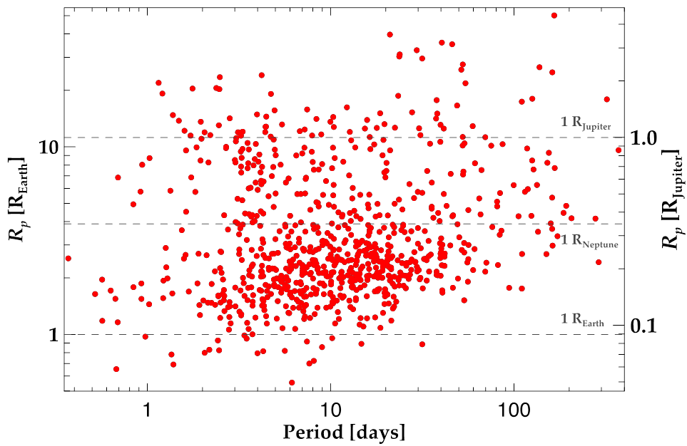
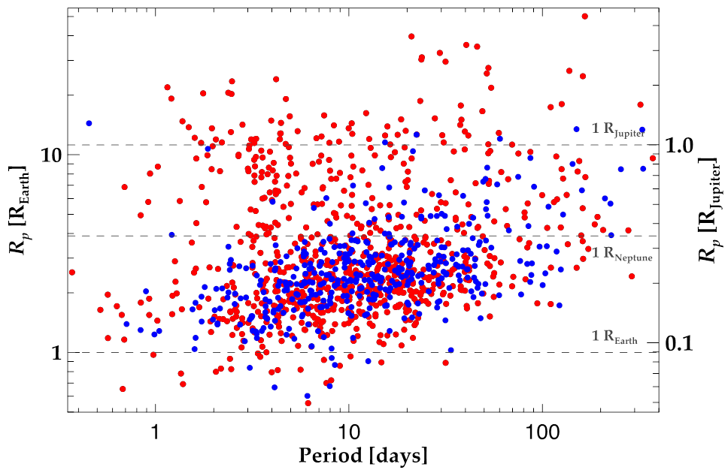

(from Spitzer)

Slide 59
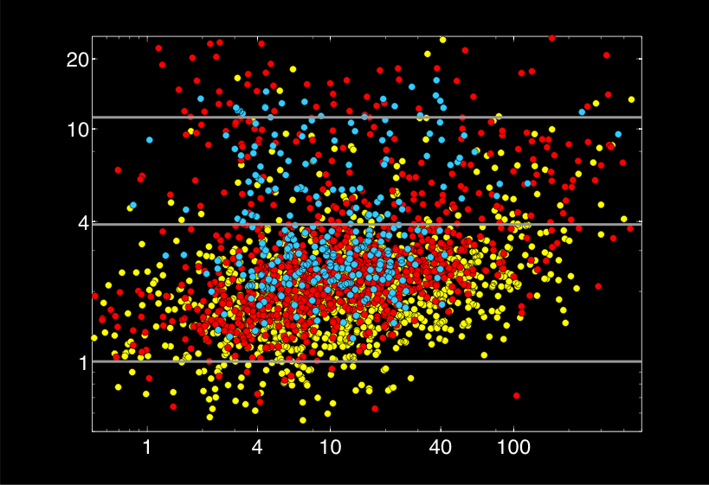
Kepler Exoplanet Candidates – Dec 2011
Radius relative to Earth
2326
Period (d)

Slide 60
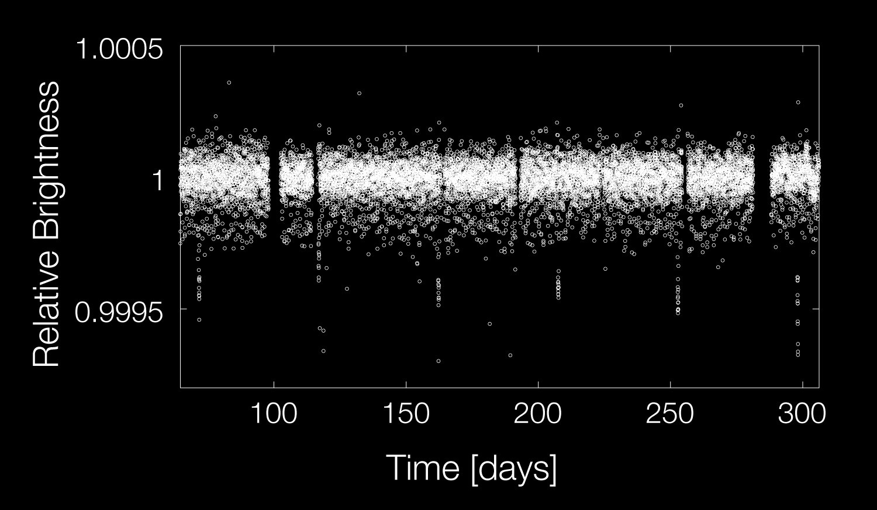
Kepler-10
Light Curve
Batalha et al. 2011
60

Slide 61
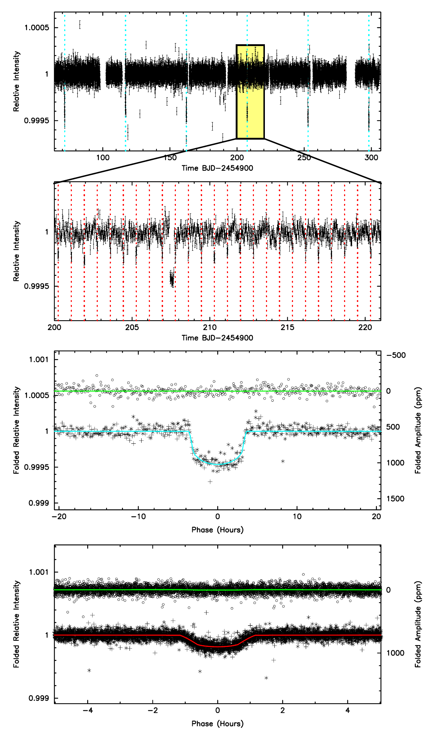

Slide 62

Kepler-10
V = 11.2

Slide 63

Kepler Exoplanet Candidates – Dec 2011
Radius relative to Earth
2326
Period (d)

Slide 64
Kepler-22b
Batalha et al. 2011

Slide 65


Slide 66


Kepler-22b

Slide 67

TrES-2b
David M. Kipping & David S. Spiegel. Monthly Notices of the Royal Astronomical Society. For all models, the geometric albedo is < 1%, and for the best-fit models it is ∼0.04%

Slide 68
Kepler-11
Lissauer et al. 2011

Slide 69


Slide 71


Slide 73
Kepler: 827 Single Planet Systems Detected
408 candidates in 170 multiple systems

Slide 74
Kepler is extended to the end 2016
Radius relative to Earth
?
2326
Period (d)

Slide 75



